Slide 1
Fairness

Slide 2
Fairness in Face Recognition is the process of correcting and mitigating algorithmic bias (for example, bias of race and ethnicity, gender, age, etc.) from face recognition models.
Fairness

Slide 3
How good is an algorithm?
What is “good”...?

Slide 4
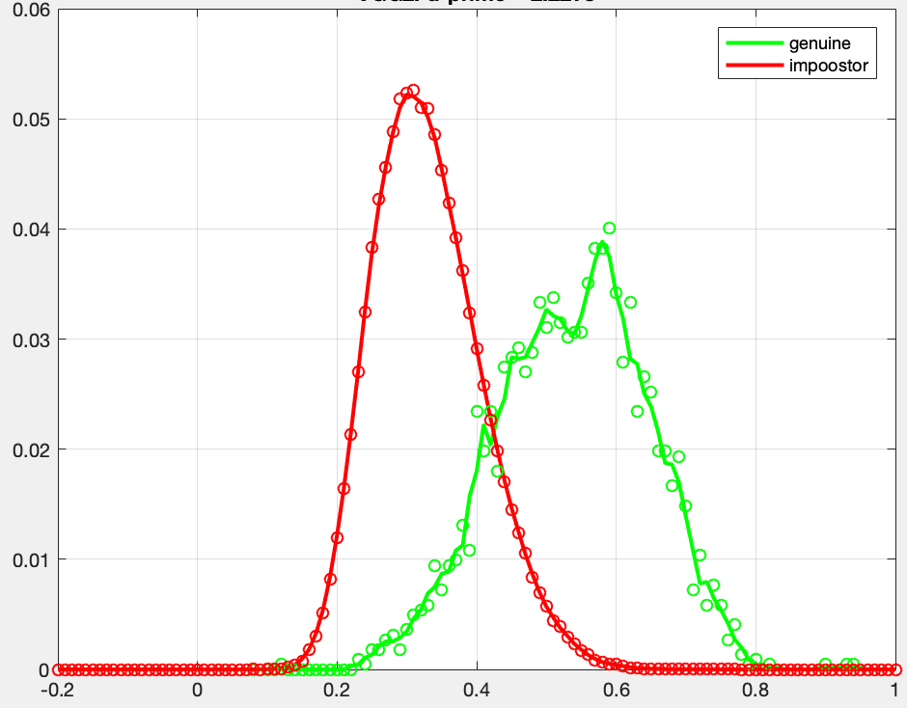
Some statistics
Distribution of d-
Probability density frequency
Distribution of d+
Area of each
distribution = 1
S
Performance:

Slide 5
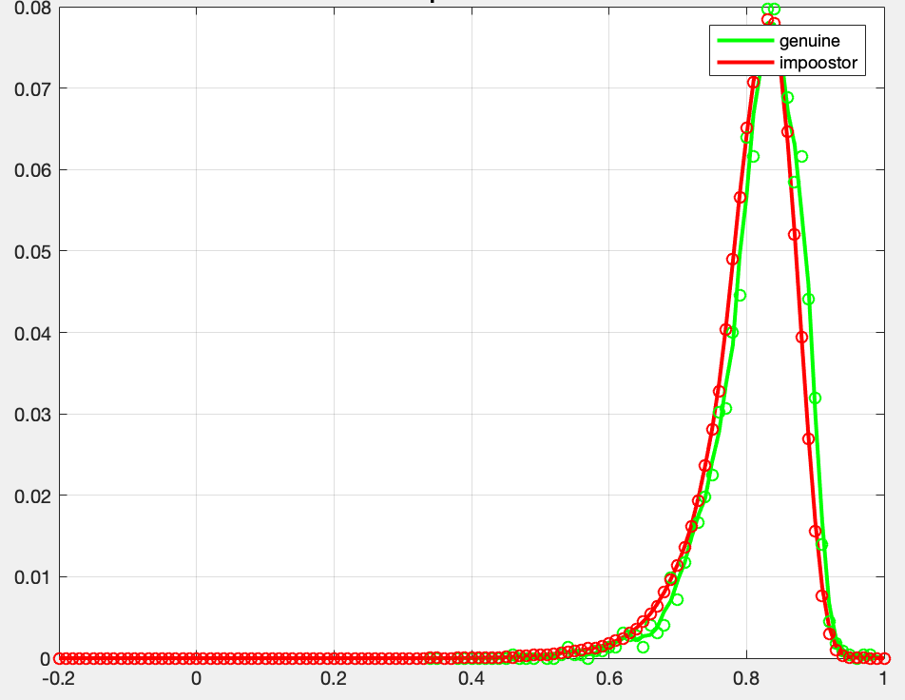
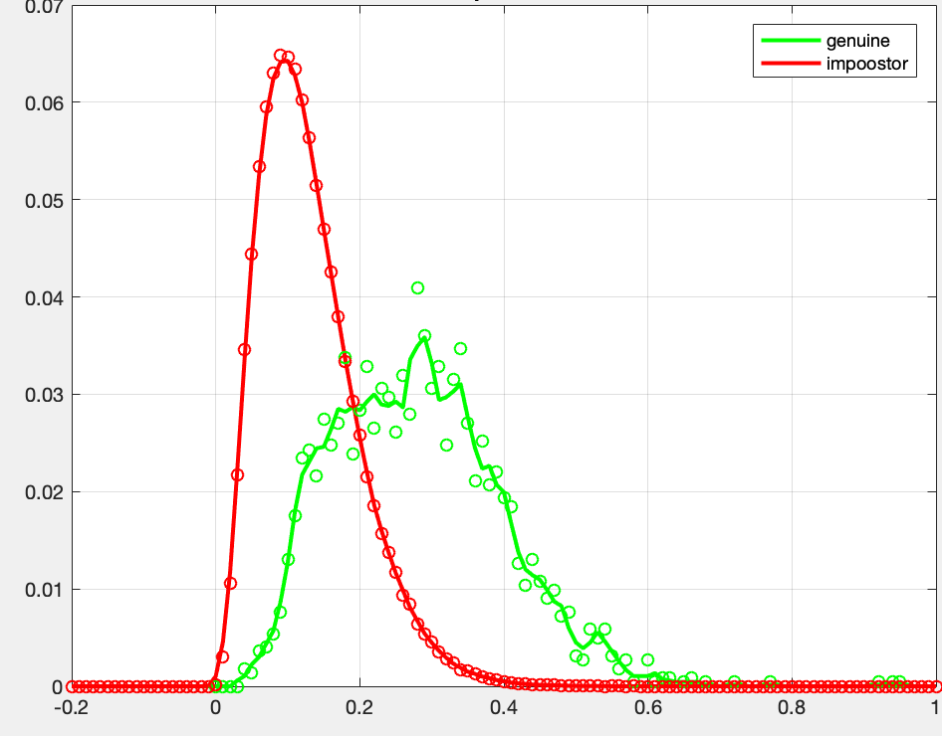
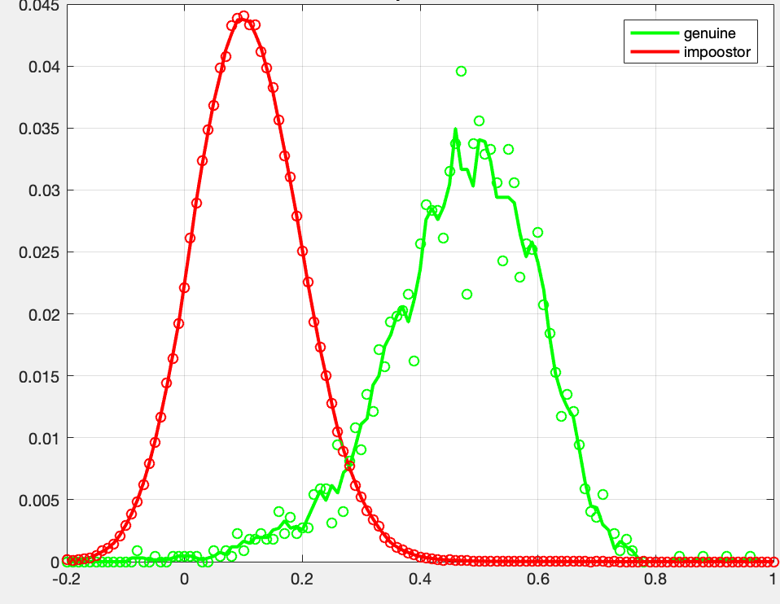
Some statistics
Examples of d’
for different algorithms
d’ = 0.20
d’ = 1.59
d’ = 2.22
d’ = 3.23
The best one

Slide 6

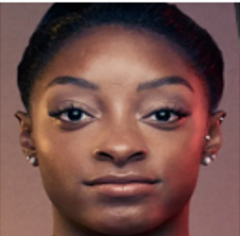
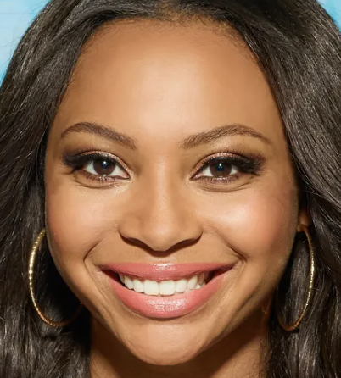
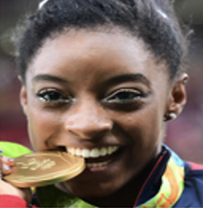
Some statistics
Probability density frequency
ERROR: FMR
ERROR: FNMR
S
Faces of different persons, but they were matched
Faces of the same person, but there is no match
FNMR
False Non-Match Rate
FMR
False Match Rate
threshold

Slide 7
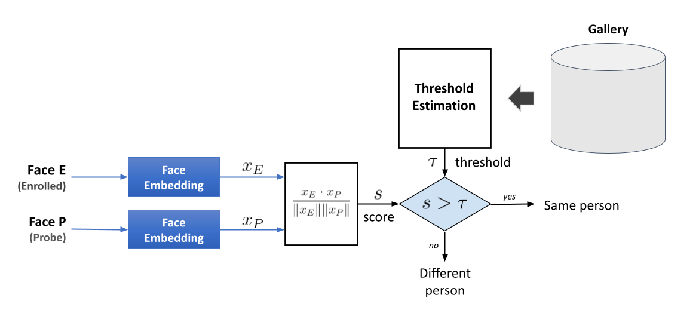


Face Verification using a Global Threshold
Standard Facial Verification Approach
sc

Slide 8
Is the performance of an algorithm the same for all demographic groups?
Unfortunately, it is not ...

Slide 9
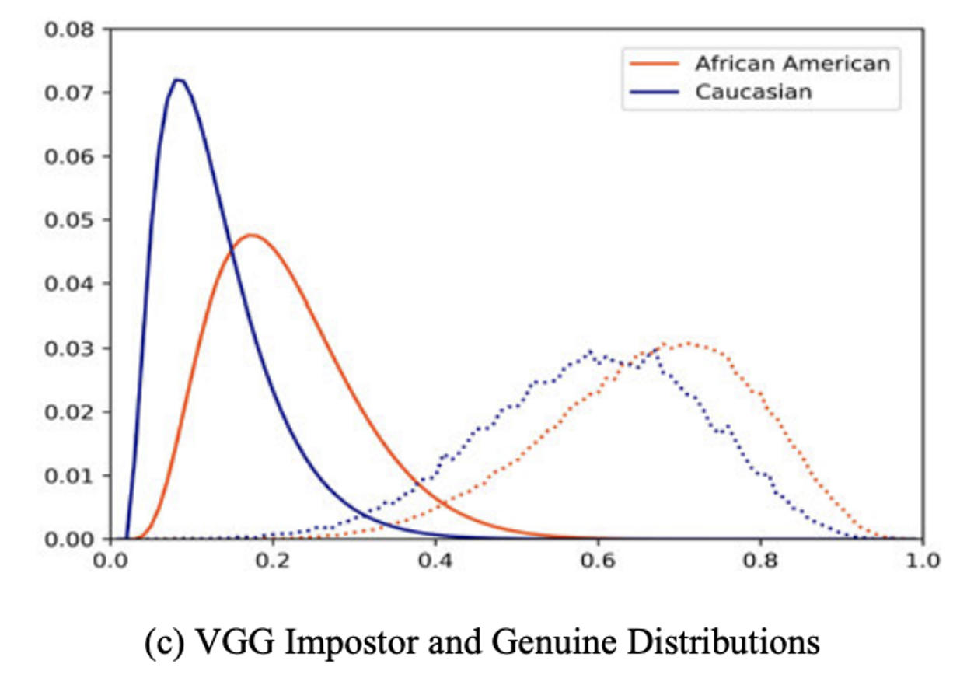
Genuine – Impostor Distribution for VGG
Global
Threshold

Slide 10
Genuine – Impostor Distribution for VGG
Introduction - Related Work - Proposed Methods - Methodology - Results - Conclusions
Threshold for
Caucasian
Total
Afro-American
Threshold for
Afro-American
Caucasian
Global
Threshold
Vangara, K., King, M. C., Albiero, V., & Bowyer, K. (2019). Characterizing the variability in face recognition accuracy relative to race. In Proceedings of the IEEE/CVF Conference on Computer Vision and Pattern Recognition Workshops

Slide 11
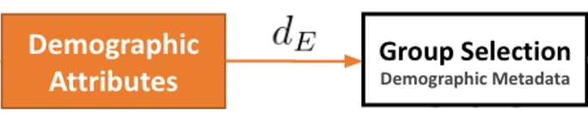
Face Verification using Demographic Thresholds
Standard Facial Verification Approach
sc

Slide 12

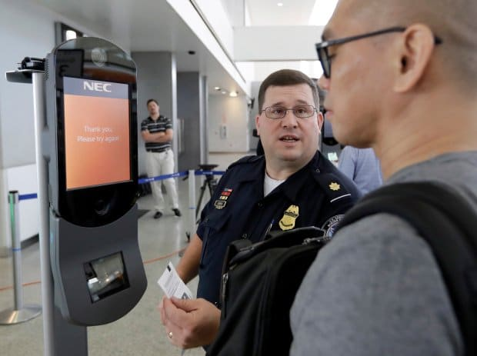

Should we use demographics in operational settings?
🤬
I’m Alaska Native
Introduction - Related Work - Proposed Methods - Methodology - Results - Conclusions
Excuse me, Sir, our algorithm says that you are an afro-american male...
Is it OK with you?
How to define a Demographic Group?
How specific should the group be?
only gender? or gender+race+age?
How many “races” should be defined?
Do we use an exhaustive list?
I’m non-binary
How to deal with sensitive information?
Both requesting and predicting demographic groups can be deemed controversial for facial recognition
(c) Esteban Villalobos
Image retrieved from: https://www.biometricupdate.com/202007/u-s-homeland-security-biometrics-leaders-discuss-public-engagement-privacy-and-legislation
Notes:
Explicar con situación

Slide 13
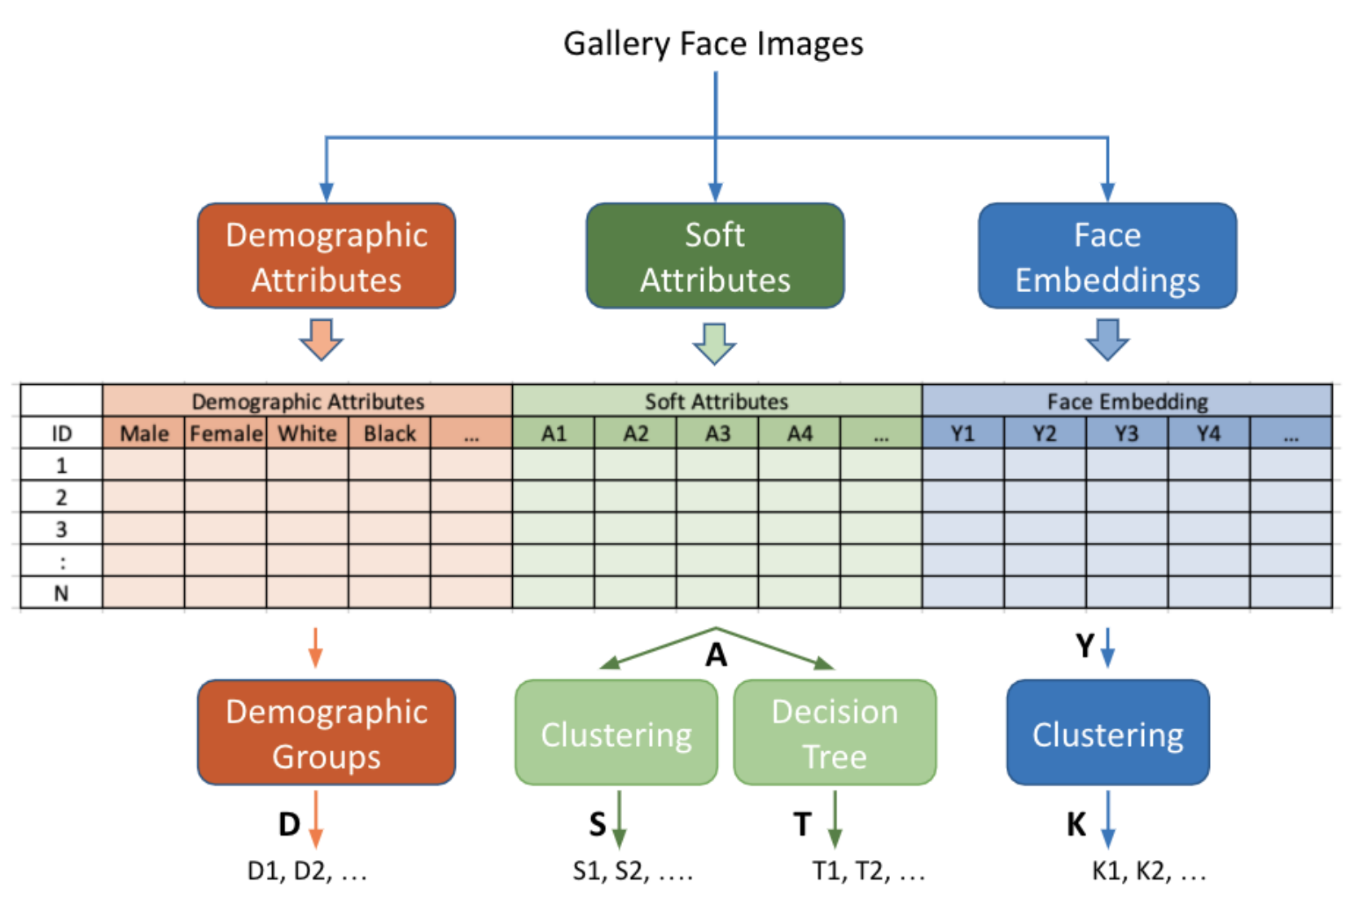

Slide 14

Face Verification using Soft Thresholds
Standard Facial Verification Approach
sc

Slide 15
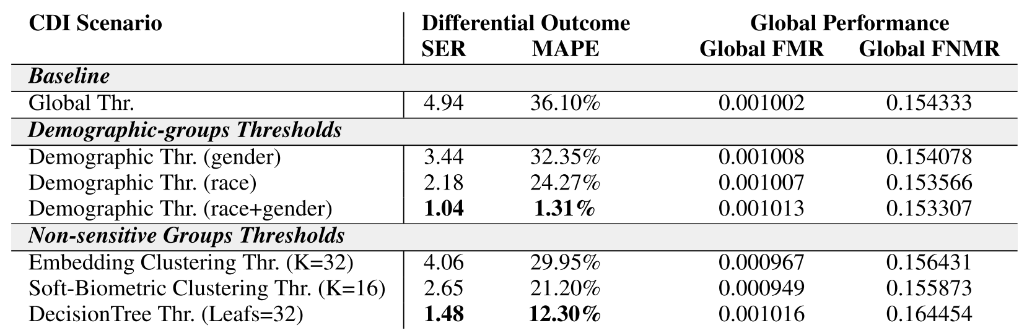
Villalobos E, Mery D, Bowyer K. Fair Face Verification by Using Non-Sensitive Soft-Biometric Attributes. IEEE Access. 2022 Mar 11;10:30168-79.

Slide 16
Low-Quality Face Recognition

Slide 17
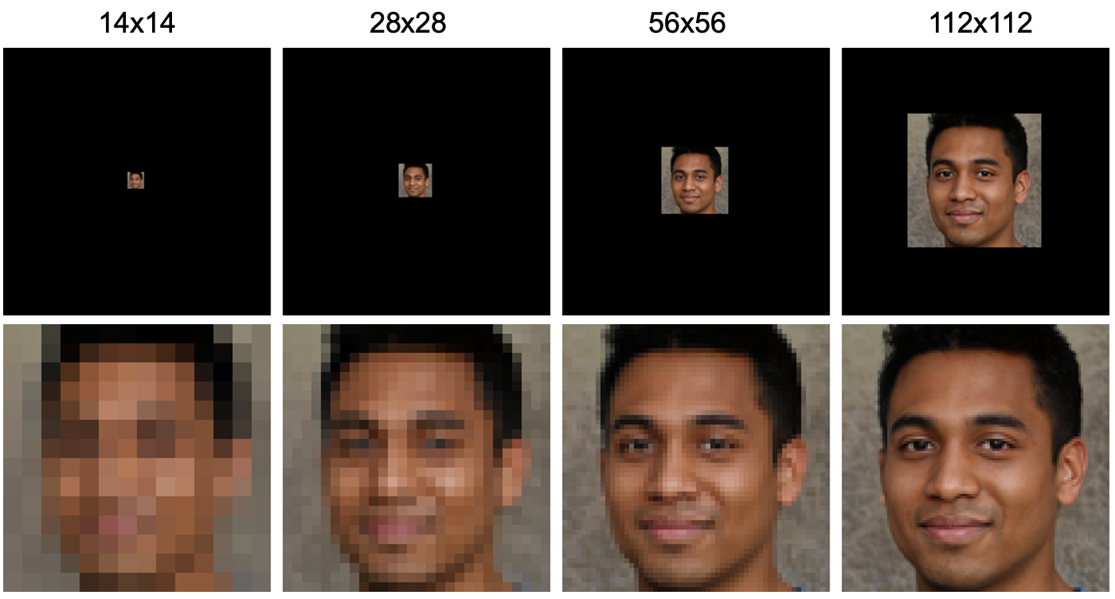
Example of low-resolution face images

Slide 18
Standard face verification approach
HR
sc

Slide 19

Low-resolution face verification approach
HR
HR
112 x 112
2
LR
14x14
28x28
56x56
SR
112 x 112
sc
Prieto, L., Pulgar, S., Flynn, P., & Mery, D. (2022, November). On Low-Resolution Face Re-identification with High-Resolution-Mapping. In Pacific-Rim Symposium on Image and Video Technology (PSIVT2022). (pp. 89-102). Cham: Springer International Publishing.
SR
UPSCALE
2
1

Slide 20
Experiments
2
Type | # | Name | Up-Scaling | Feature Extraction
Baseline | 1 | Bi-Arc | Bicubic interpolation | ArcFace
Simple | 2 | Bi-Face | Bicubic interpolation | FaceNet
TGAN | 3 | TGAN-Arc | Trained GAN | ArcFace
 | 4 | TGAN-GSia | Trained GAN | GAN trained siamese
Interpol+GTS | 5 | Area-GTS | Re-sampling using pixel area relation | GAN trained siamese
 | 6 | Bi-GTS | Bicubic interpolation | GAN trained siamese
 | 7 | Lanc-GTS | Lanczos interpolation over 8x8 pixels | GAN trained siamese
 | 8 | NN-GTS | Nearest neighbor interpolation | GAN trained siamese
Interpol+TS | 9 | Area-TS | Re-sampling using pixel area relation | Area trained siamese
 | 10 | Bi-TS | Bicubic interpolation | Bicubic trained siamese
 | 11 | Lanc-TS | Lanczos interpolation over 8x8 pixels | Lanczos trained siamese
 | 12 | NN-TS | Nearest neighbor interpolation | Nearest trained siamese
GAN’s | 13 | ESRGAN-TSia | ESRGAN | GAN trained siamese
 | 14 | GPEN256-Arc | GPEN256 | ArcFace
 | 15 | GPEN512-Arc | GPEN512 | ArcFace
 | 16 | GFPGAN1-Arc | GFPGAN1 | ArcFace
 | 17 | GFPGAN2-Arc | GFPGAN2 | ArcFace
 | 18 | EGFPGAN2-Arc | EGFPGAN2 | ArcFace
1

Slide 21
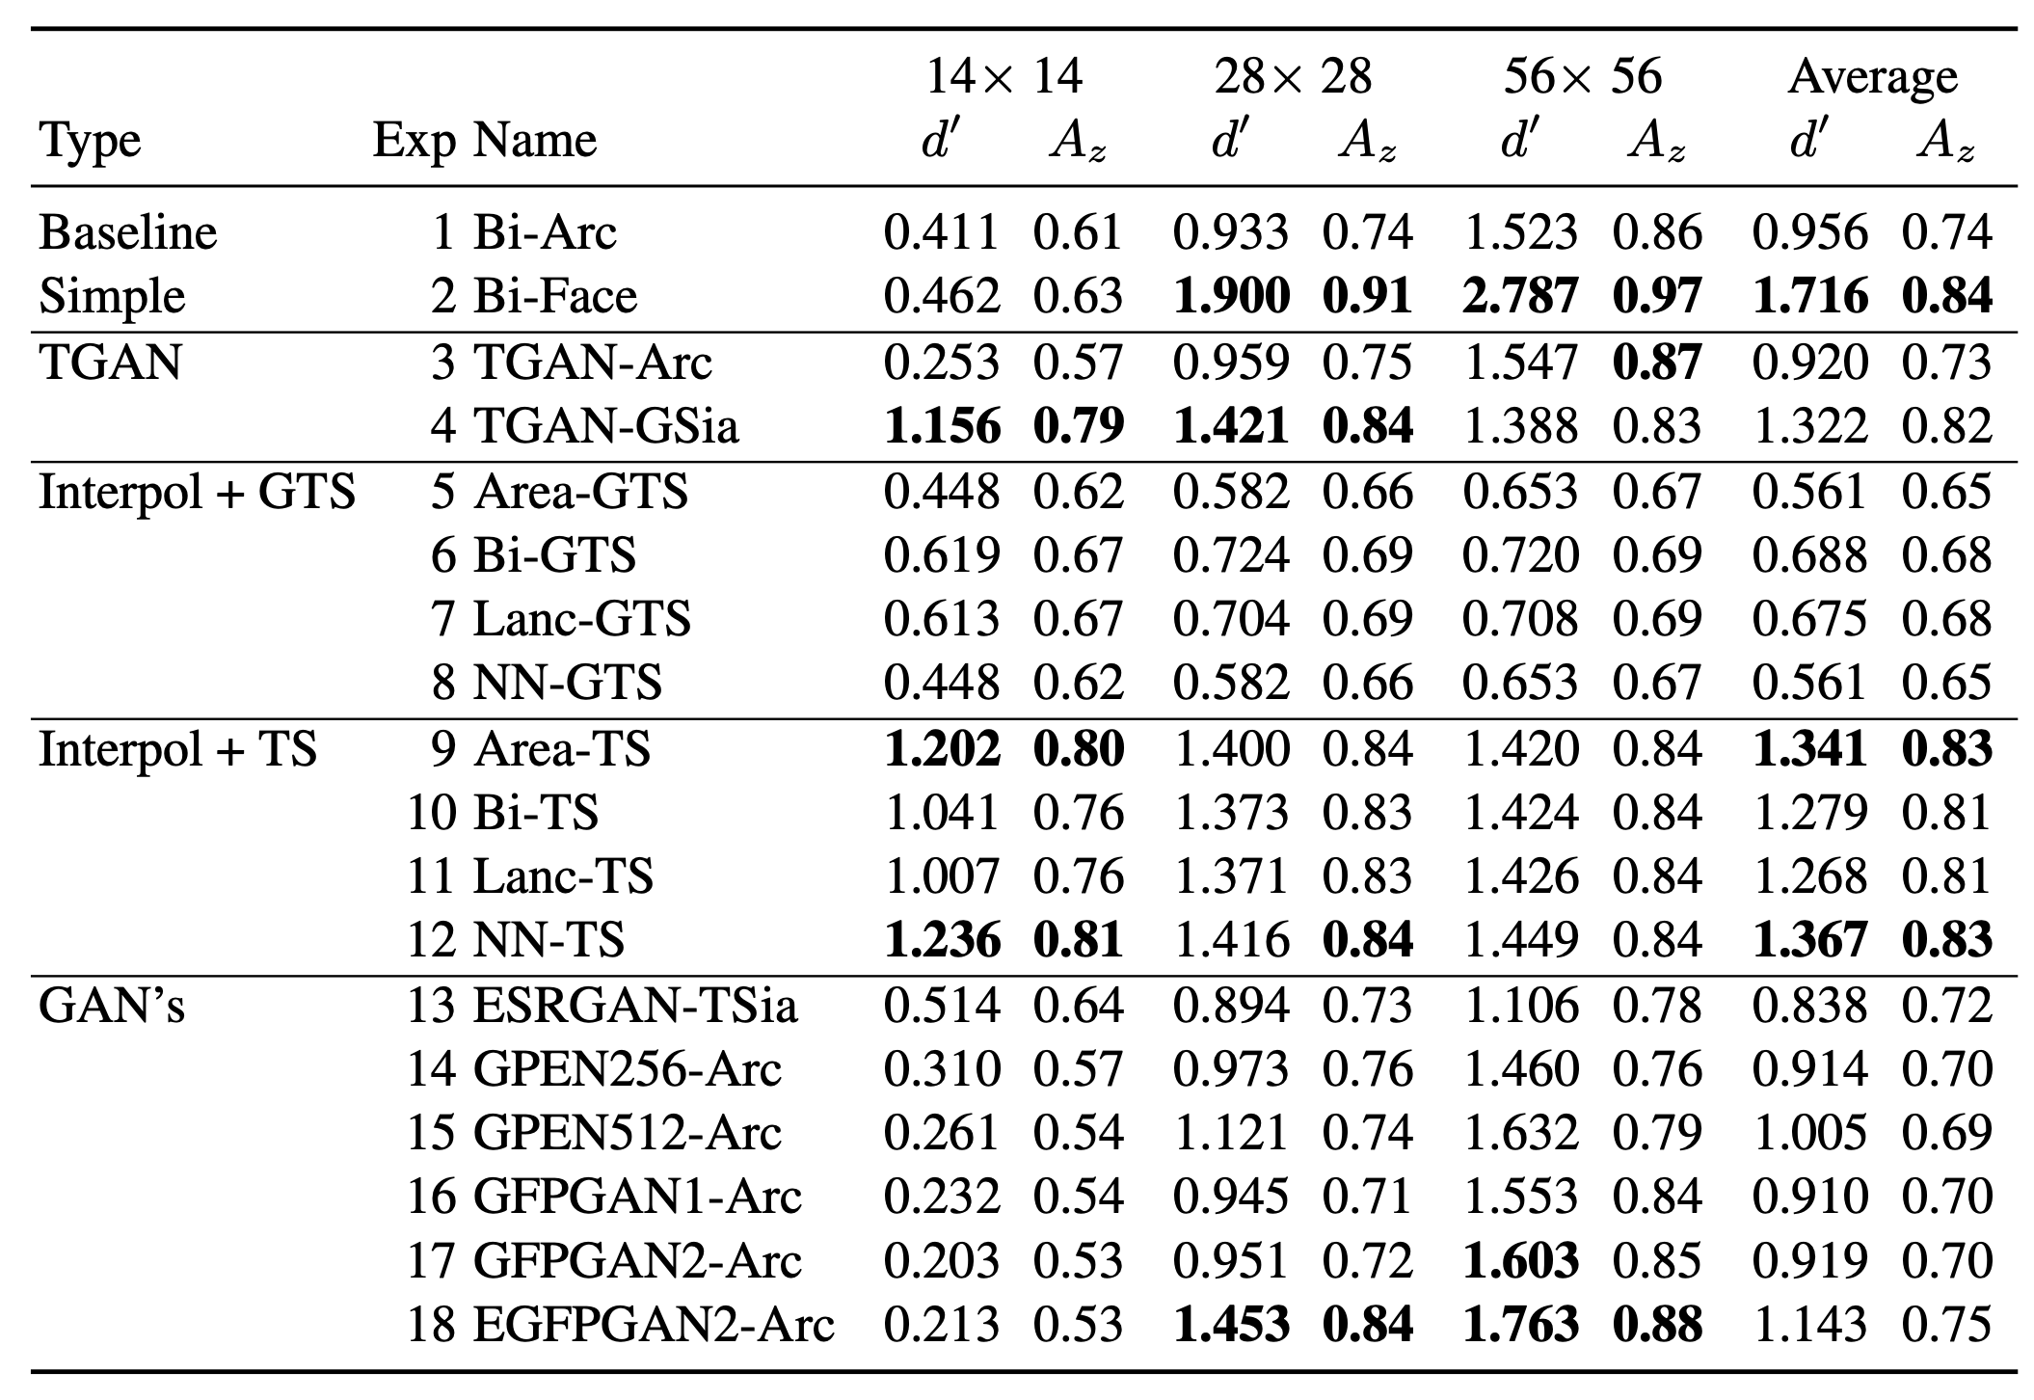
Experiments
Type | Exp | Name | Up-Scaling | Feature Extraction
Baseline | 1 | Bi-Arc | Bicubic interpolation | ArcFace
Simple | 2 | Bi-Face | Bicubic interpolation | FaceNet
TGAN | 3 | TGAN-Arc | Trained GAN | ArcFace
 | 4 | TGAN-GSia | Trained GAN | GAN trained siamese
Interpol+GTS | 5 | Area-GTS | Re-sampling using pixel area relation | GAN trained siamese
 | 6 | Bi-GTS | Bicubic interpolation | GAN trained siamese
 | 7 | Lanc-GTS | Lanczos interpolation over 8x8 pixels | GAN trained siamese
 | 8 | NN-GTS | Nearest neighbor interpolation | GAN trained siamese
Interpol+TS | 9 | Area-TS | Re-sampling using pixel area relation | Area trained siamese
 | 10 | Bi-TS | Bicubic interpolation | Bicubic trained siamese
 | 11 | Lanc-TS | Lanczos interpolation over 8x8 pixels | Lanczos trained siamese
 | 12 | NN-TS | Nearest neighbor interpolation | Nearest trained siamese
GAN’s | 13 | ESRGAN-TSia | ESRGAN | GAN trained siamese
 | 14 | GPEN256-Arc | GPEN256 | ArcFace
 | 15 | GPEN512-Arc | GPEN512 | ArcFace
 | 16 | GFPGAN1-Arc | GFPGAN1 | ArcFace
 | 17 | GFPGAN2-Arc | GFPGAN2 | ArcFace
 | 18 | EGFPGAN2-Arc | EGFPGAN2 | ArcFace

Slide 22
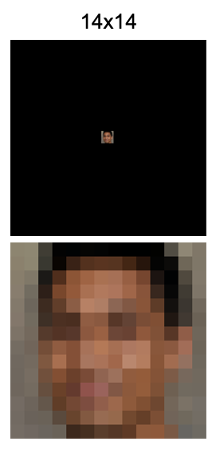
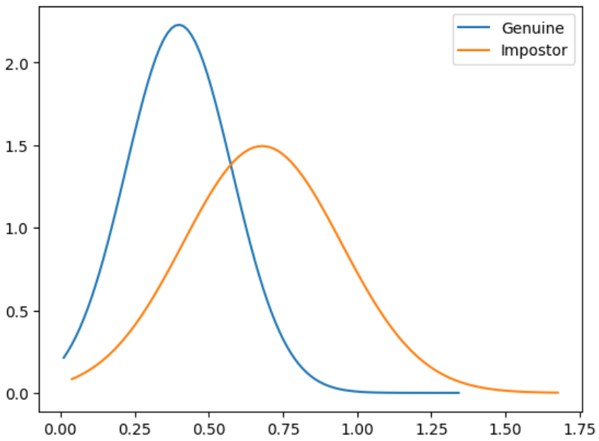
Experiments
Type | Exp | Name | Up-Scaling | Feature Extraction
Baseline | 1 | Bi-Arc | Bicubic interpolation | ArcFace
Simple | 2 | Bi-Face | Bicubic interpolation | FaceNet
TGAN | 3 | TGAN-Arc | Trained GAN | ArcFace
 | 4 | TGAN-GSia | Trained GAN | GAN trained siamese
Interpol+GTS | 5 | Area-GTS | Re-sampling using pixel area relation | GAN trained siamese
 | 6 | Bi-GTS | Bicubic interpolation | GAN trained siamese
 | 7 | Lanc-GTS | Lanczos interpolation over 8x8 pixels | GAN trained siamese
 | 8 | NN-GTS | Nearest neighbor interpolation | GAN trained siamese
Interpol+TS | 9 | Area-TS | Re-sampling using pixel area relation | Area trained siamese
 | 10 | Bi-TS | Bicubic interpolation | Bicubic trained siamese
 | 11 | Lanc-TS | Lanczos interpolation over 8x8 pixels | Lanczos trained siamese
 | 12 | NN-TS | Nearest neighbor interpolation | Nearest trained siamese
GAN’s | 13 | ESRGAN-TSia | ESRGAN | GAN trained siamese
 | 14 | GPEN256-Arc | GPEN256 | ArcFace
 | 15 | GPEN512-Arc | GPEN512 | ArcFace
 | 16 | GFPGAN1-Arc | GFPGAN1 | ArcFace
 | 17 | GFPGAN2-Arc | GFPGAN2 | ArcFace
 | 18 | EGFPGAN2-Arc | EGFPGAN2 | ArcFace

Slide 23
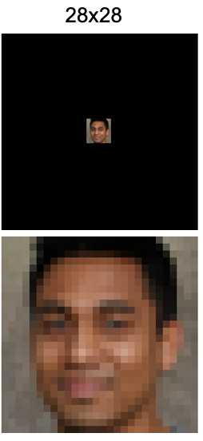
Experiments
Type | Exp | Name | Up-Scaling | Feature Extraction
Baseline | 1 | Bi-Arc | Bicubic interpolation | ArcFace
Simple | 2 | Bi-Face | Bicubic interpolation | FaceNet
TGAN | 3 | TGAN-Arc | Trained GAN | ArcFace
 | 4 | TGAN-GSia | Trained GAN | GAN trained siamese
Interpol+GTS | 5 | Area-GTS | Re-sampling using pixel area relation | GAN trained siamese
 | 6 | Bi-GTS | Bicubic interpolation | GAN trained siamese
 | 7 | Lanc-GTS | Lanczos interpolation over 8x8 pixels | GAN trained siamese
 | 8 | NN-GTS | Nearest neighbor interpolation | GAN trained siamese
Interpol+TS | 9 | Area-TS | Re-sampling using pixel area relation | Area trained siamese
 | 10 | Bi-TS | Bicubic interpolation | Bicubic trained siamese
 | 11 | Lanc-TS | Lanczos interpolation over 8x8 pixels | Lanczos trained siamese
 | 12 | NN-TS | Nearest neighbor interpolation | Nearest trained siamese
GAN’s | 13 | ESRGAN-TSia | ESRGAN | GAN trained siamese
 | 14 | GPEN256-Arc | GPEN256 | ArcFace
 | 15 | GPEN512-Arc | GPEN512 | ArcFace
 | 16 | GFPGAN1-Arc | GFPGAN1 | ArcFace
 | 17 | GFPGAN2-Arc | GFPGAN2 | ArcFace
 | 18 | EGFPGAN2-Arc | EGFPGAN2 | ArcFace

Slide 24
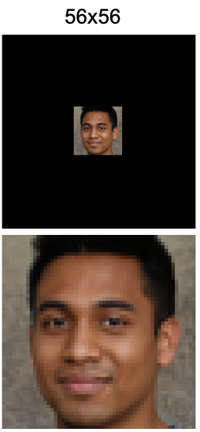
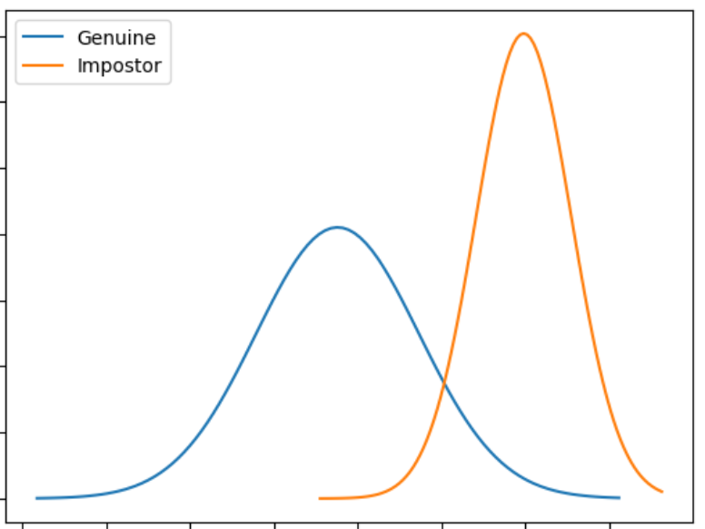
Experiments
Type | Exp | Name | Up-Scaling | Feature Extraction
Baseline | 1 | Bi-Arc | Bicubic interpolation | ArcFace
Simple | 2 | Bi-Face | Bicubic interpolation | FaceNet
TGAN | 3 | TGAN-Arc | Trained GAN | ArcFace
 | 4 | TGAN-GSia | Trained GAN | GAN trained siamese
Interpol+GTS | 5 | Area-GTS | Re-sampling using pixel area relation | GAN trained siamese
 | 6 | Bi-GTS | Bicubic interpolation | GAN trained siamese
 | 7 | Lanc-GTS | Lanczos interpolation over 8x8 pixels | GAN trained siamese
 | 8 | NN-GTS | Nearest neighbor interpolation | GAN trained siamese
Interpol+TS | 9 | Area-TS | Re-sampling using pixel area relation | Area trained siamese
 | 10 | Bi-TS | Bicubic interpolation | Bicubic trained siamese
 | 11 | Lanc-TS | Lanczos interpolation over 8x8 pixels | Lanczos trained siamese
 | 12 | NN-TS | Nearest neighbor interpolation | Nearest trained siamese
GAN’s | 13 | ESRGAN-TSia | ESRGAN | GAN trained siamese
 | 14 | GPEN256-Arc | GPEN256 | ArcFace
 | 15 | GPEN512-Arc | GPEN512 | ArcFace
 | 16 | GFPGAN1-Arc | GFPGAN1 | ArcFace
 | 17 | GFPGAN2-Arc | GFPGAN2 | ArcFace
 | 18 | EGFPGAN2-Arc | EGFPGAN2 | ArcFace

Slide 25
Experiments
Type | Exp | Name | Up-Scaling | Feature Extraction
Baseline | 1 | Bi-Arc | Bicubic interpolation | ArcFace
Simple | 2 | Bi-Face | Bicubic interpolation | FaceNet
TGAN | 3 | TGAN-Arc | Trained GAN | ArcFace
 | 4 | TGAN-GSia | Trained GAN | GAN trained siamese
Interpol+GTS | 5 | Area-GTS | Re-sampling using pixel area relation | GAN trained siamese
 | 6 | Bi-GTS | Bicubic interpolation | GAN trained siamese
 | 7 | Lanc-GTS | Lanczos interpolation over 8x8 pixels | GAN trained siamese
 | 8 | NN-GTS | Nearest neighbor interpolation | GAN trained siamese
Interpol+TS | 9 | Area-TS | Re-sampling using pixel area relation | Area trained siamese
 | 10 | Bi-TS | Bicubic interpolation | Bicubic trained siamese
 | 11 | Lanc-TS | Lanczos interpolation over 8x8 pixels | Lanczos trained siamese
 | 12 | NN-TS | Nearest neighbor interpolation | Nearest trained siamese
GAN’s | 13 | ESRGAN-TSia | ESRGAN | GAN trained siamese
 | 14 | GPEN256-Arc | GPEN256 | ArcFace
 | 15 | GPEN512-Arc | GPEN512 | ArcFace
 | 16 | GFPGAN1-Arc | GFPGAN1 | ArcFace
 | 17 | GFPGAN2-Arc | GFPGAN2 | ArcFace
 | 18 | EGFPGAN2-Arc | EGFPGAN2 | ArcFace

Slide 26
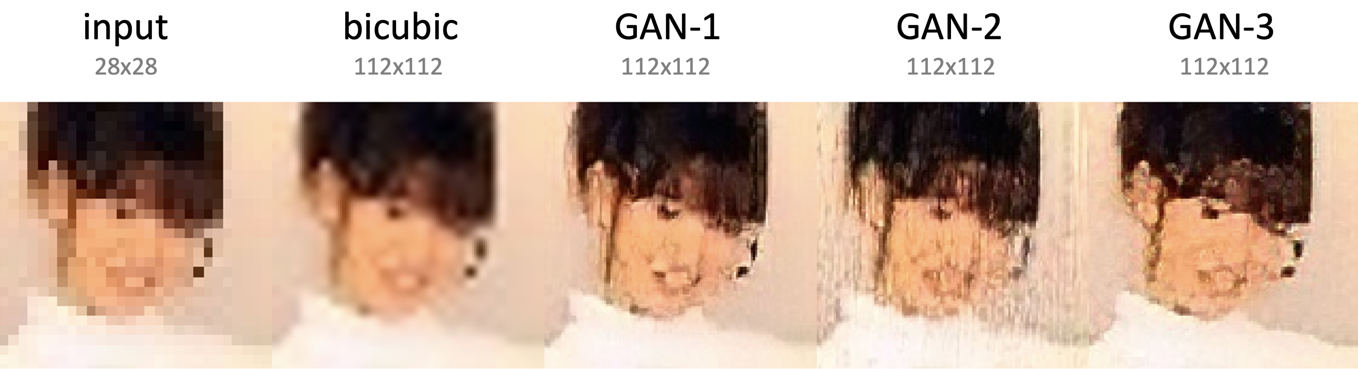
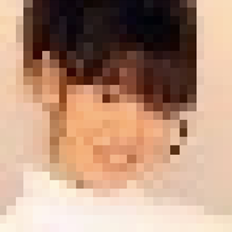
Super-resolution
examples 28x28

Slide 27
Super-resolution
examples 28x28

Slide 28
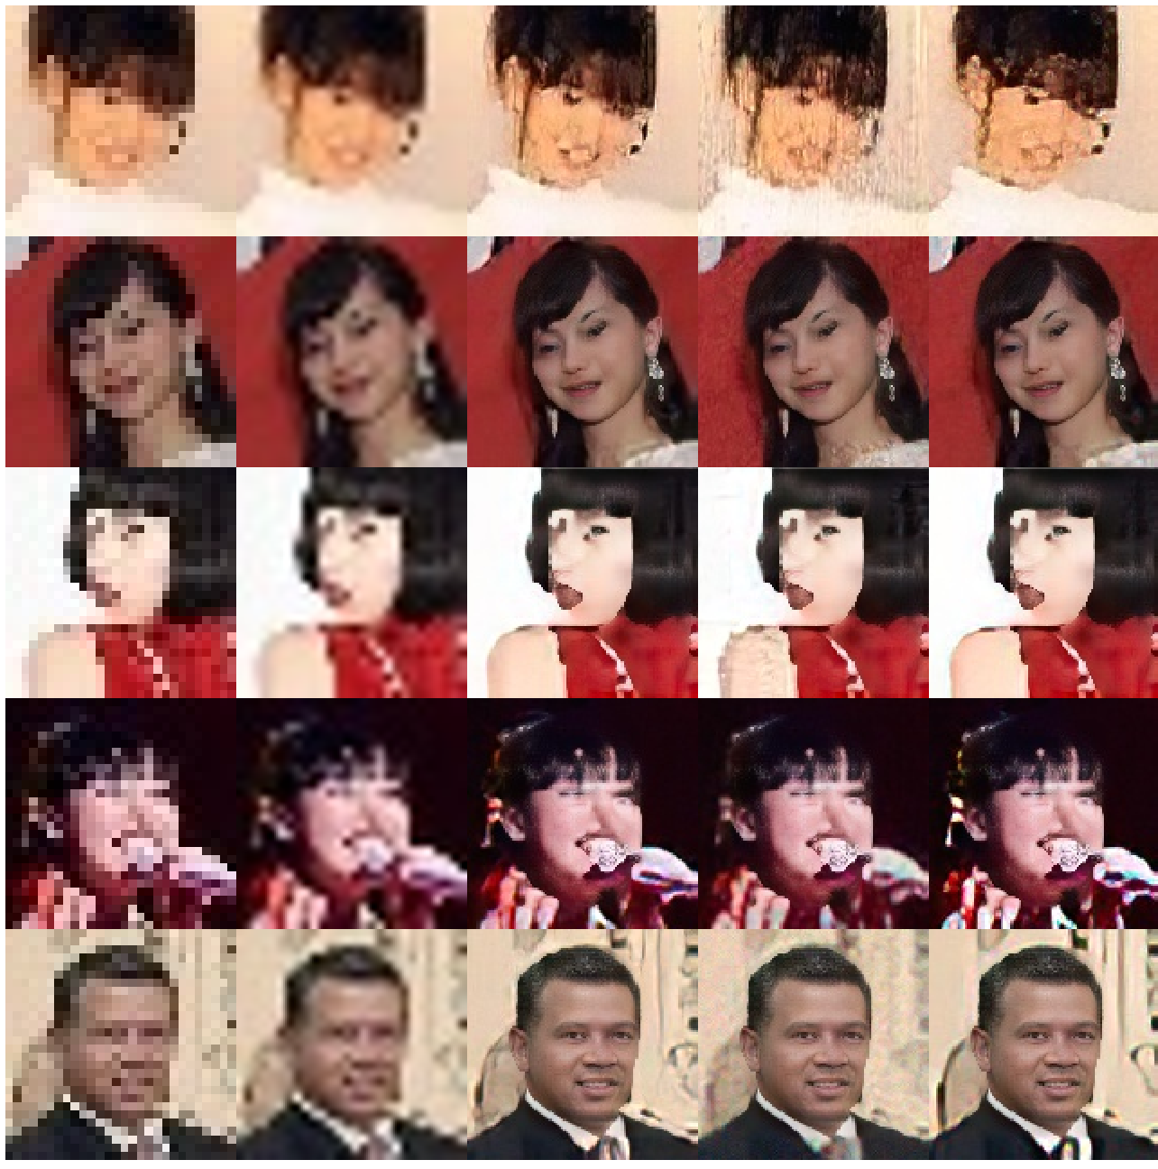
Super-resolution
examples 28x28

Slide 29
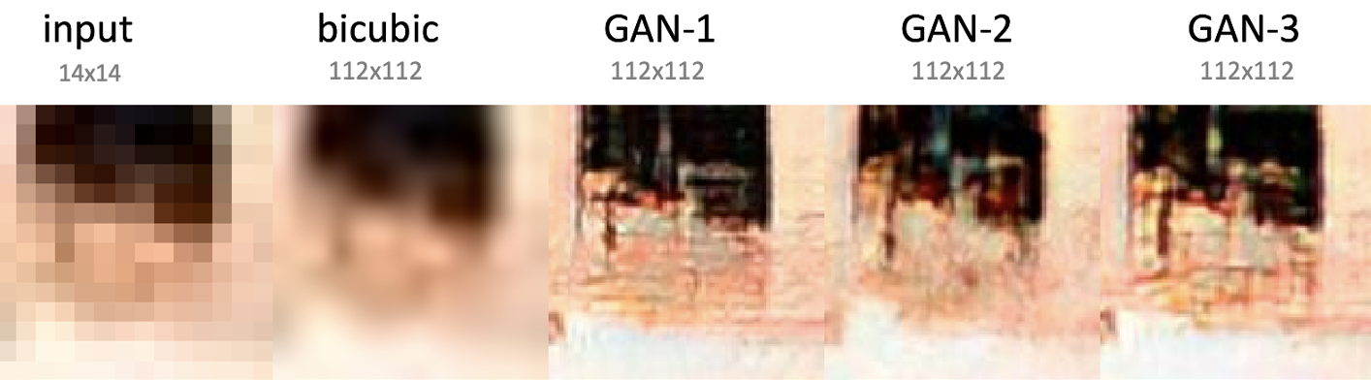

Super-resolution
examples 14x14

Slide 30
Super-resolution
examples 14x14

Slide 31
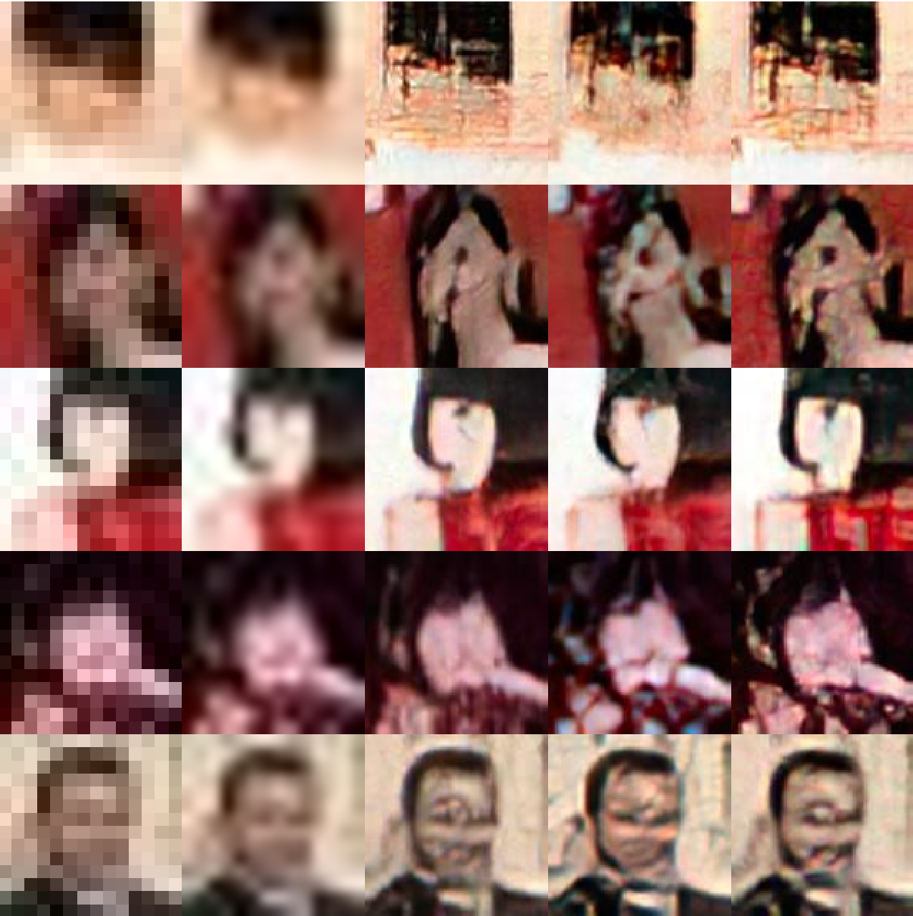
Super-resolution
examples 14x14

Slide 32
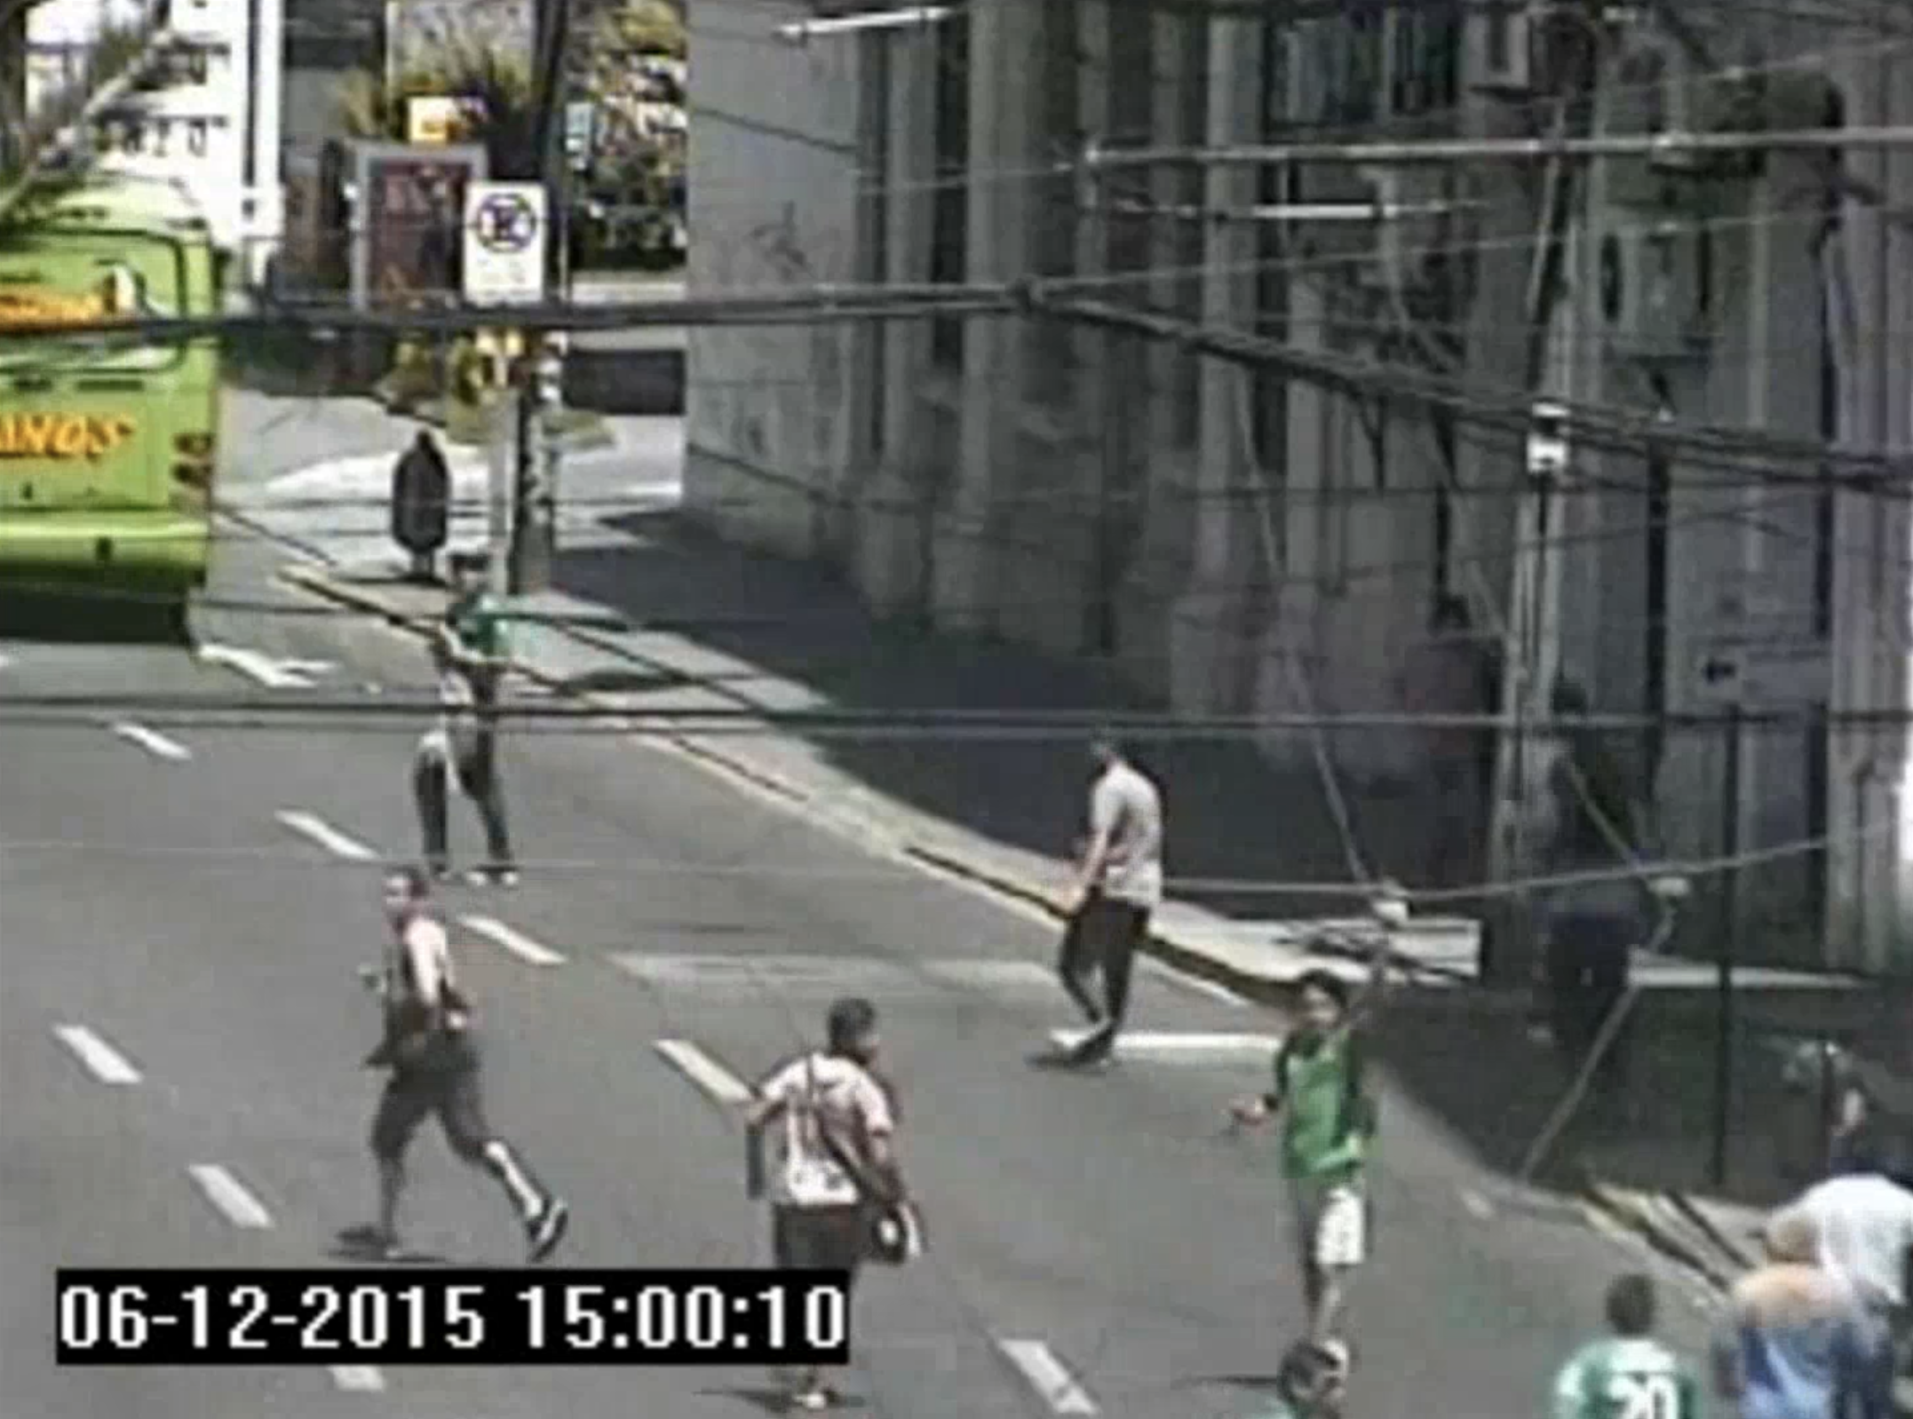


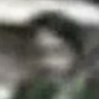
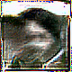
1. Who is this person?
2. Is the same person?
We don’t know. . .

Slide 33
Explainability

Slide 34
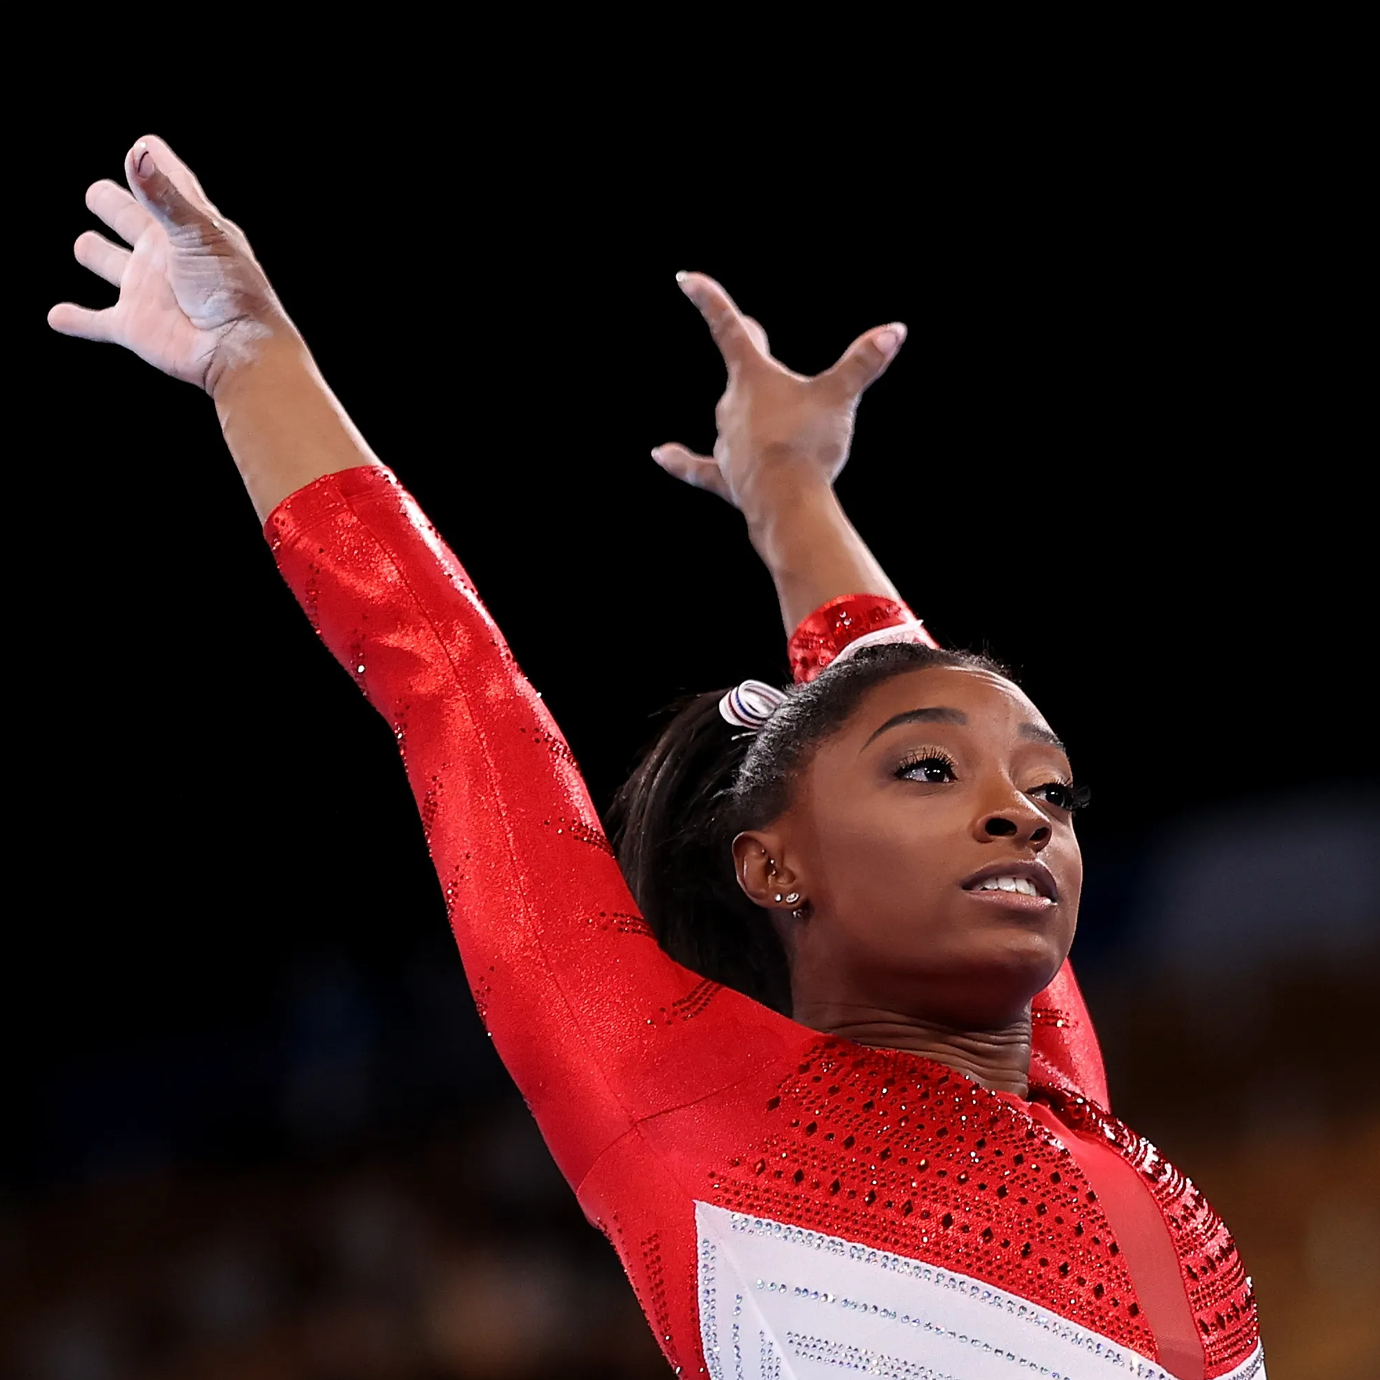
Explainability
f_{x}
Output
input
image
BLACK-BOX
Mery, D. (2022). True black-box explanation in facial analysis. In Proceedings of the IEEE/CVF Conference on Computer Vision and Pattern Recognition (pp. 1596-1605).

Slide 35
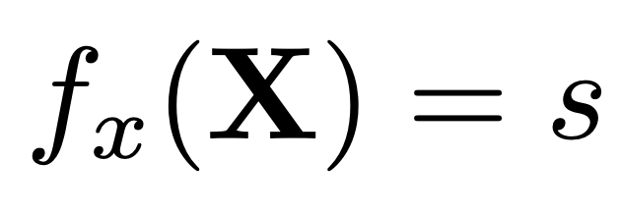
Explainability
BLACK-BOX
(model)
IMAGE
(input)
SCORE
(output)
f_{x}
X
s

Slide 36
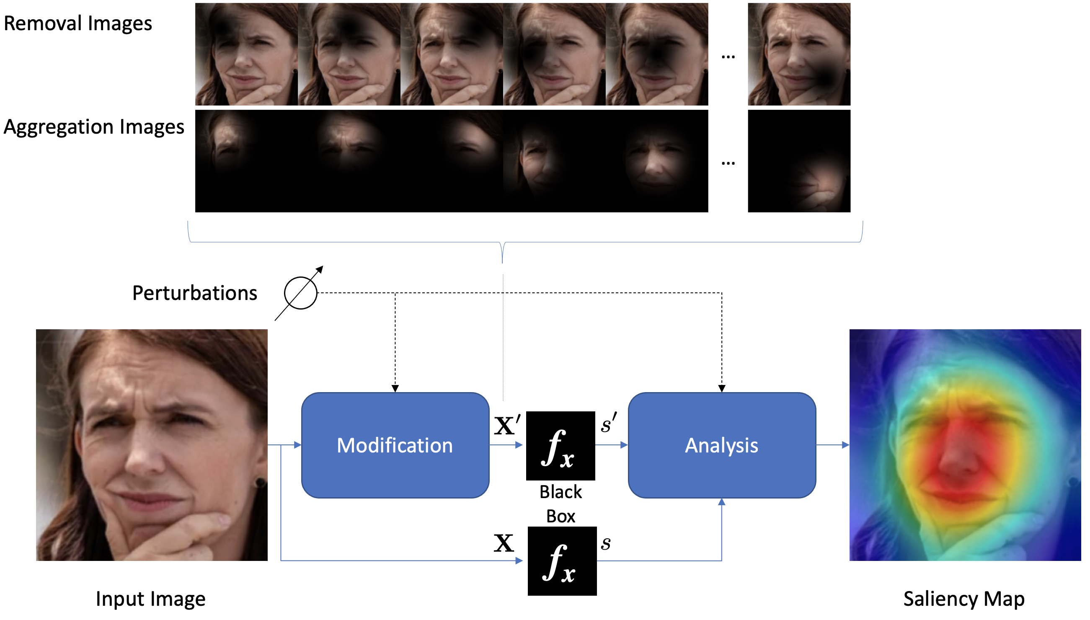
Key idea of the proposed method

Slide 38
Minus
MinPlus
Plus

Slide 39
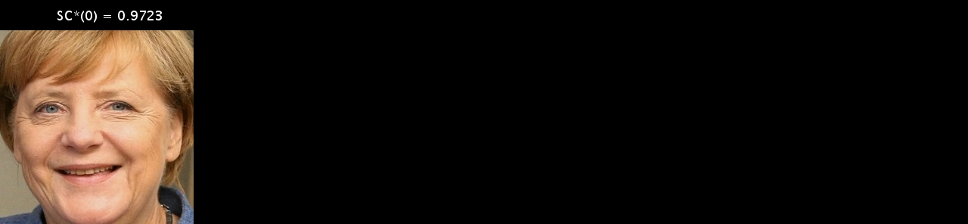
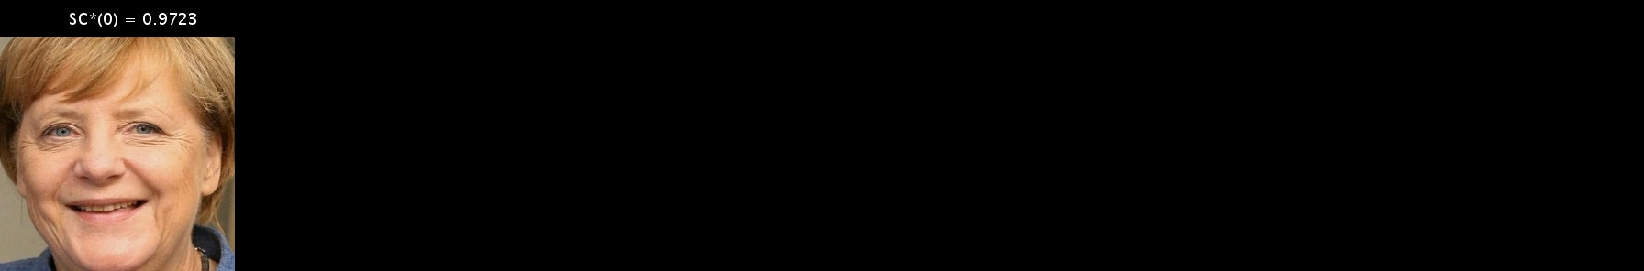
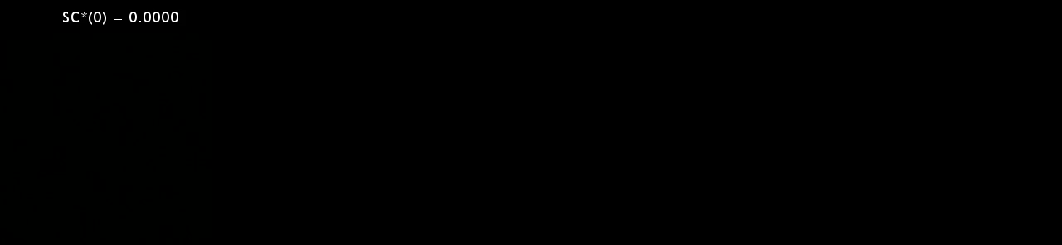
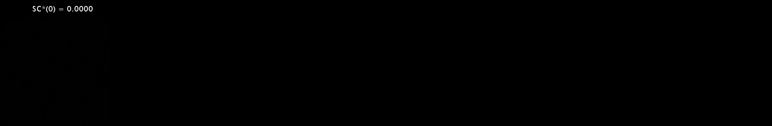

Slide 40
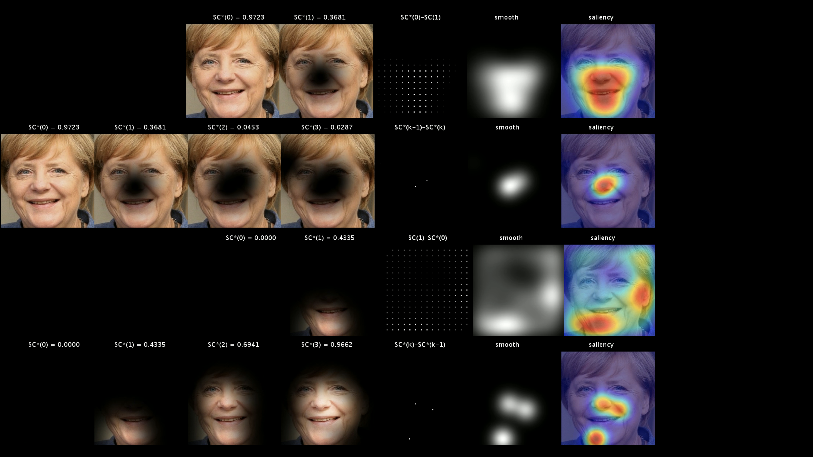
H₀–
H₁–
H₀+
H₁+

Slide 41
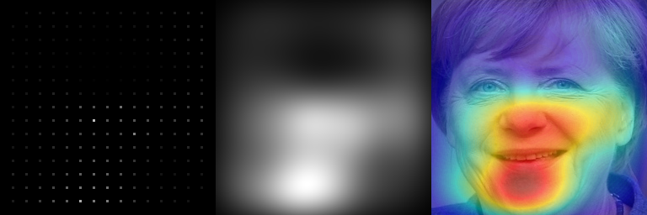
H₀–
H₁–
mean
H₀+
H₁+

Slide 42
H₀–
H₁–
mean smooth
H₀+
H₁+

Slide 43
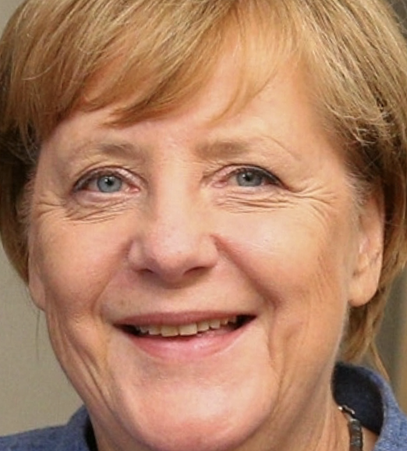
H₀–
H₁–
mean smooth saliency
H₀+
MinPlus
H₁+

Slide 44
Explanation: Relevant parts of the model for happiness
MinPlus
H₀–
H₀+
H₁–
H₁+

Slide 45
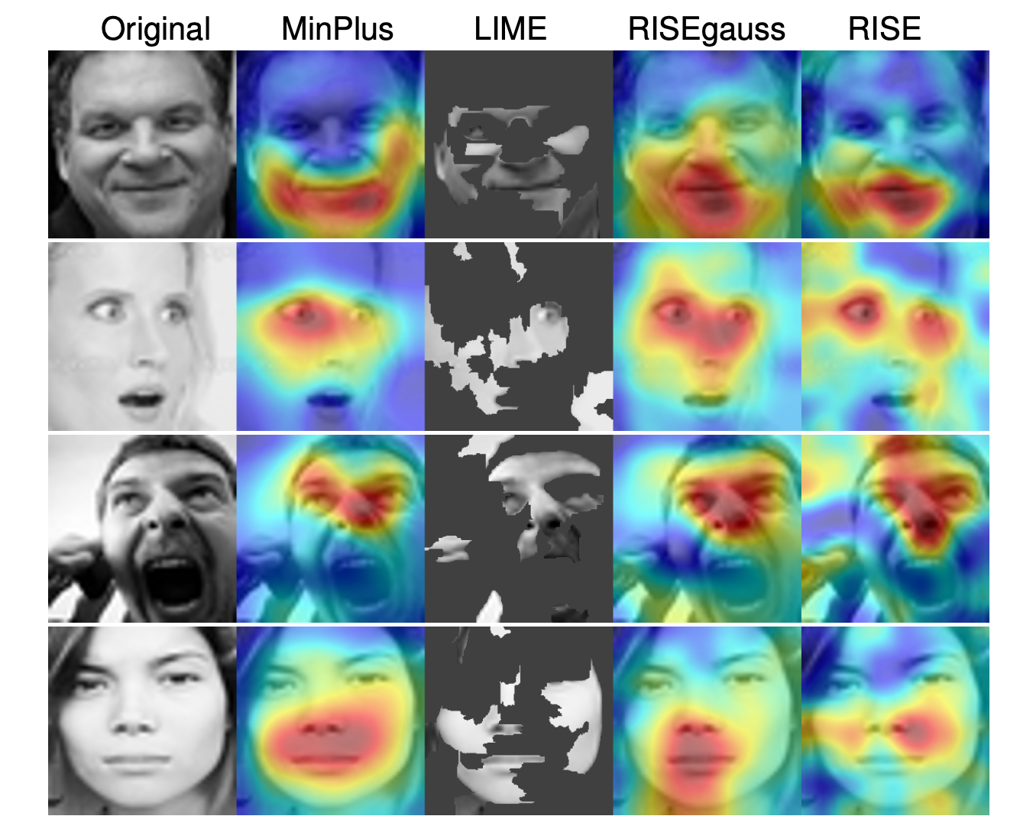
HAPPINESS
Saliency Maps for recognition of expressions using Xception
SURPREISE
ANGRY
NEUTRAL

Slide 46
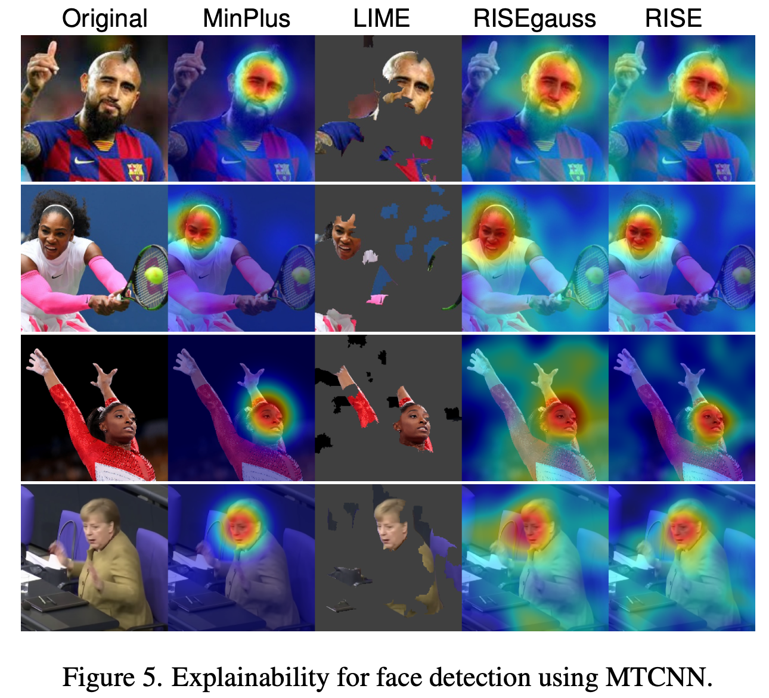
Saliency Maps for face detection using MTCNN

Slide 47
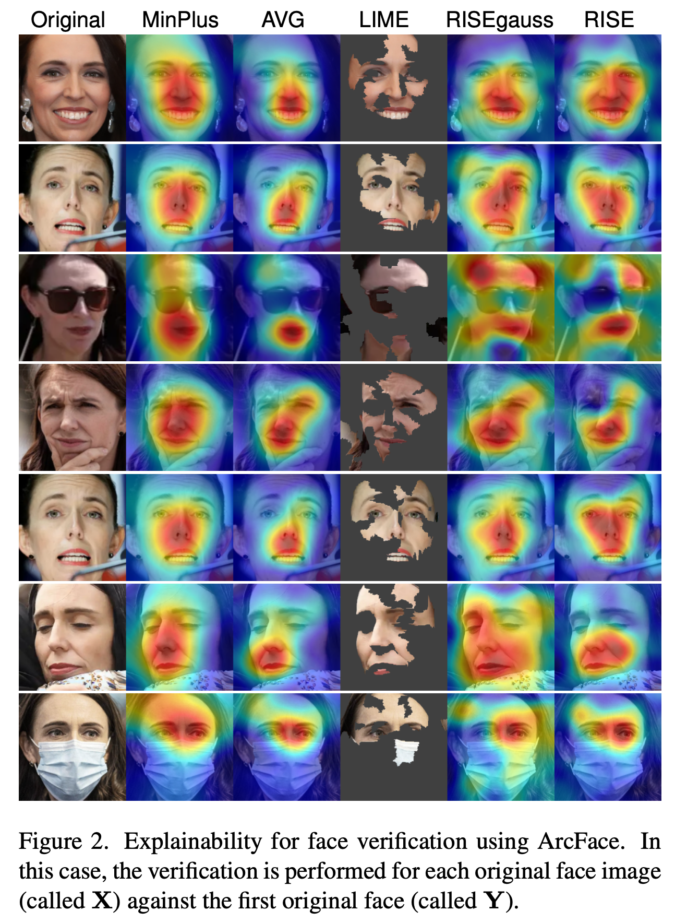
Face Verification
using ArcFace

Slide 48
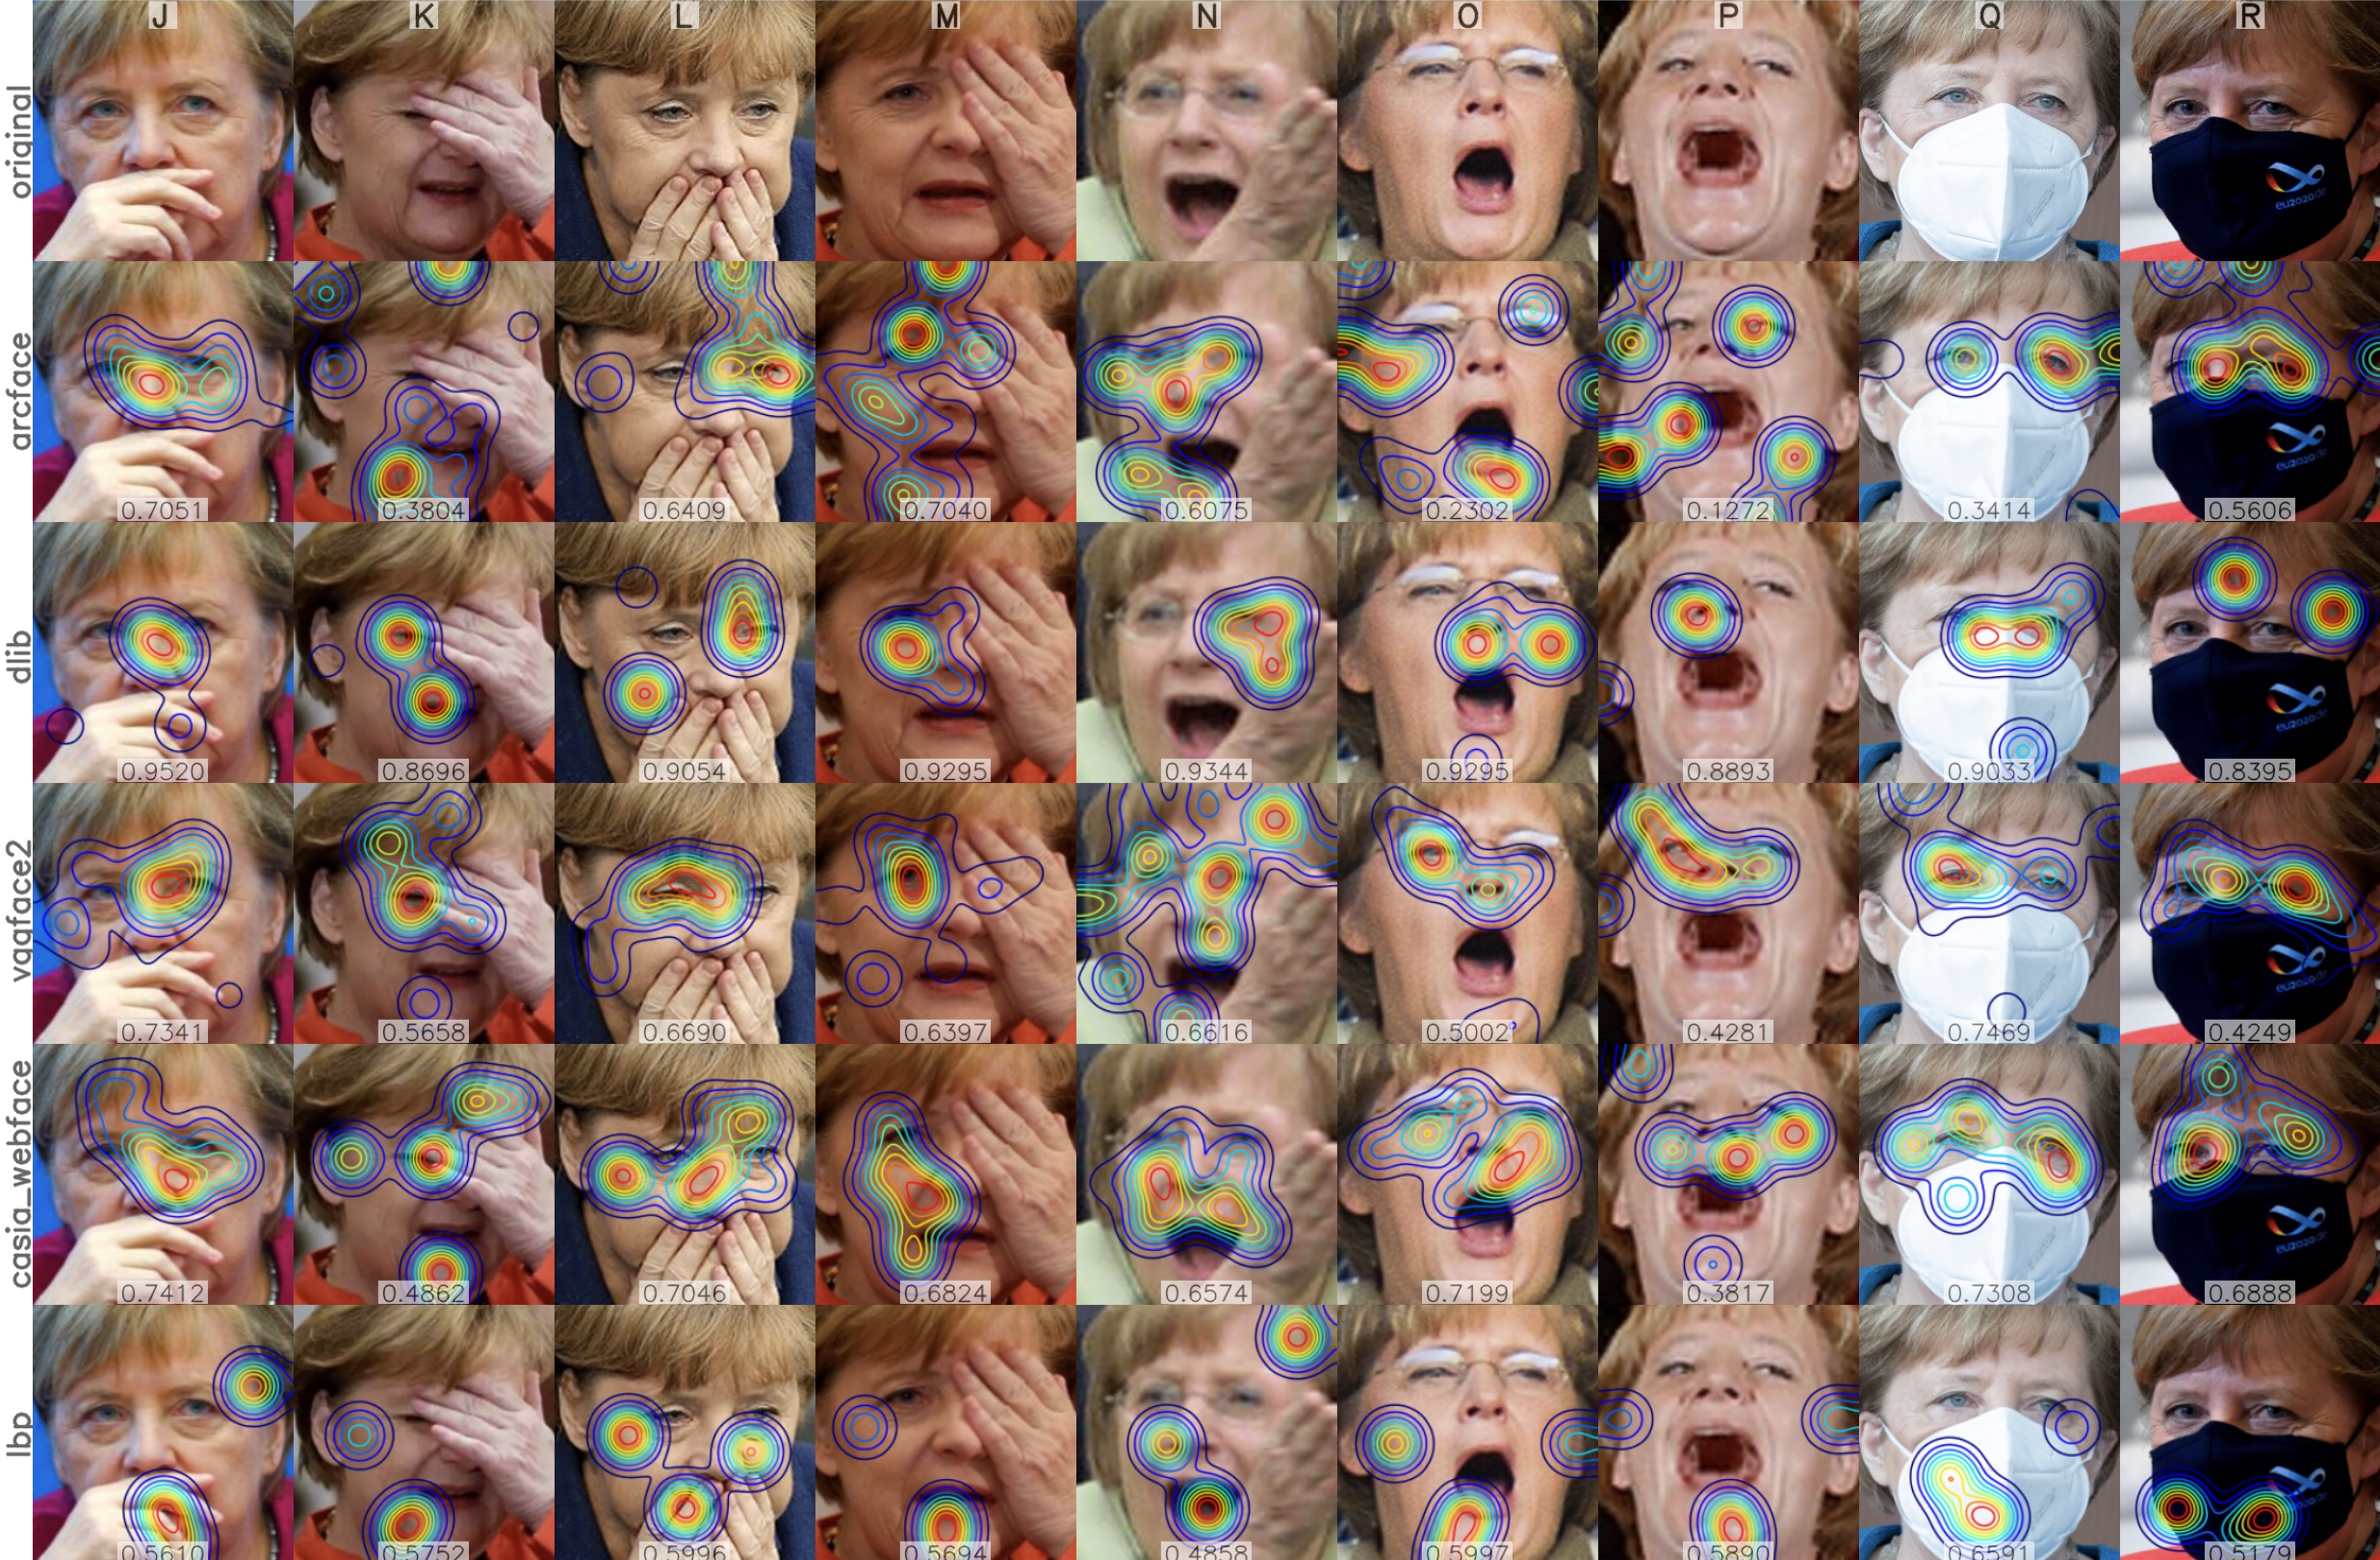
Face Verification:
Real face images with different facial expressions, poses, and occlusions for different matchers

Slide 49
Social Interactions

Slide 50
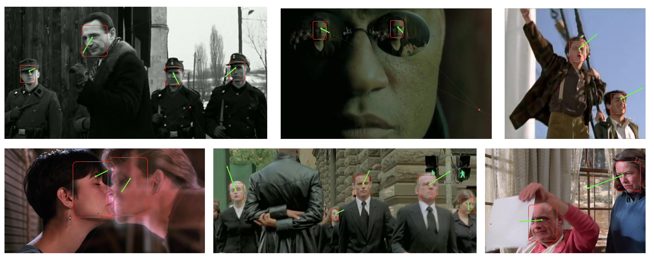
Social Networks: Interactions

Slide 51
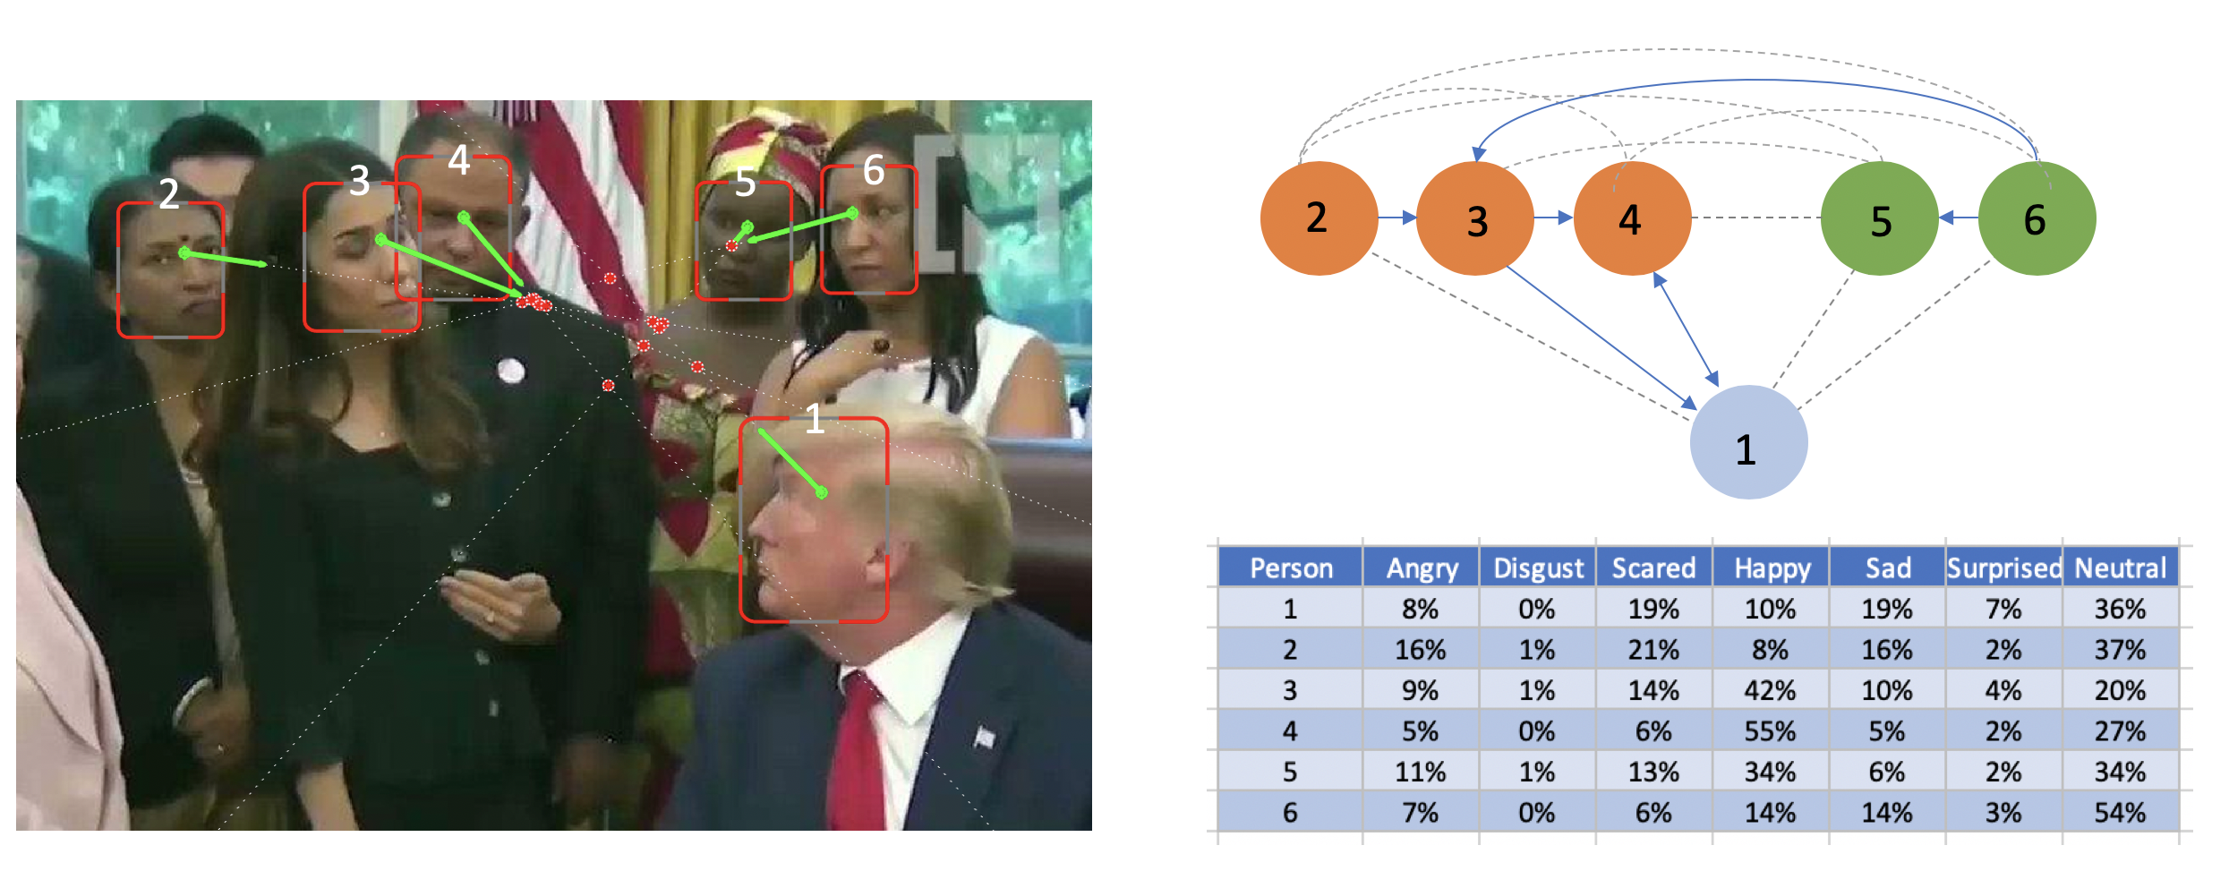
Social Networks: Interactions

Slide 52

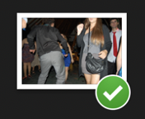
Analysis of
Image
Collections
Wedding
Celebration

Slide 53
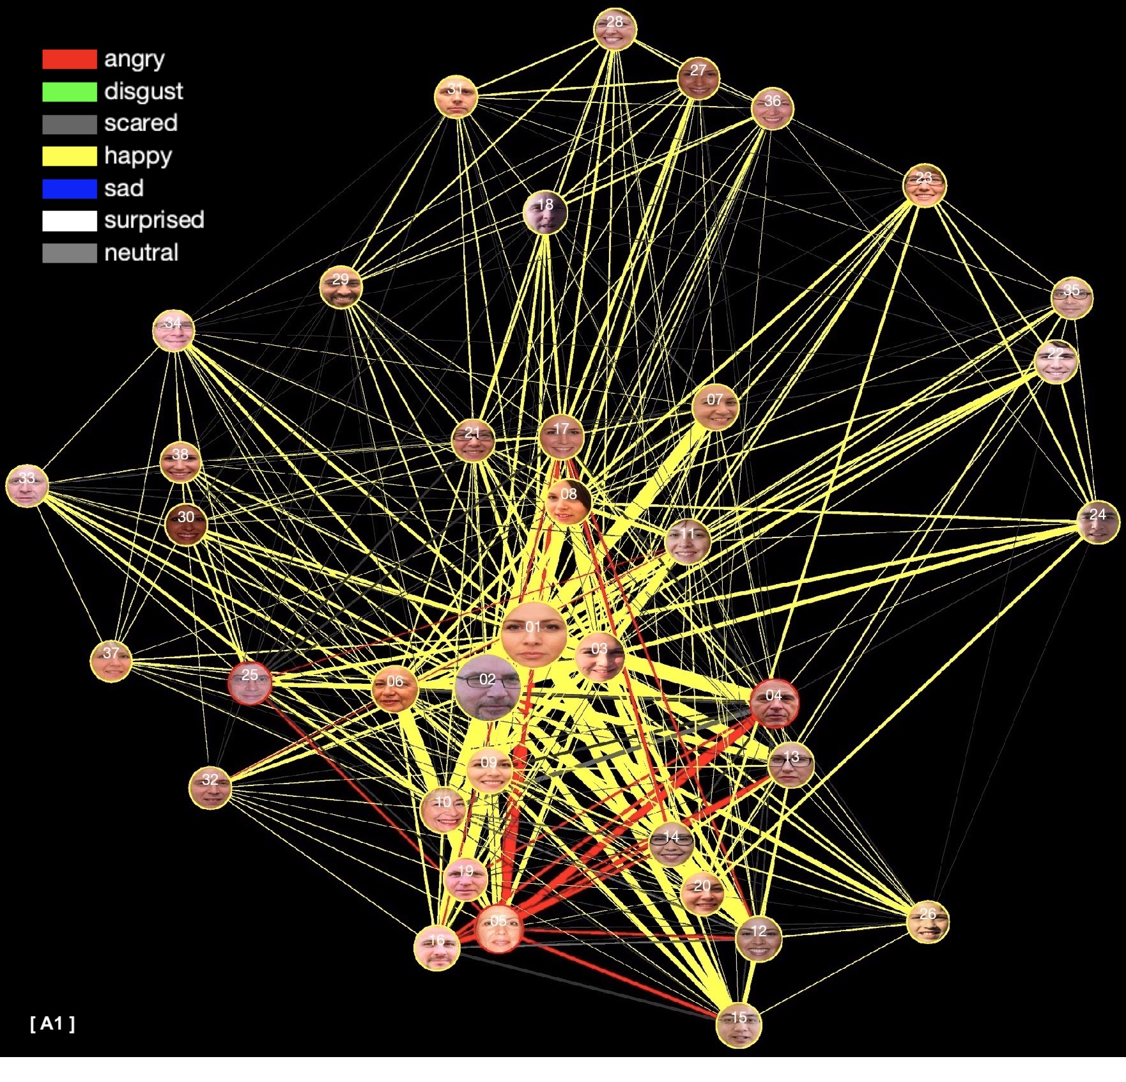
Analysis of
Image
Collections
Wedding
Celebration
Expressions

Slide 54
Aging

Slide 55
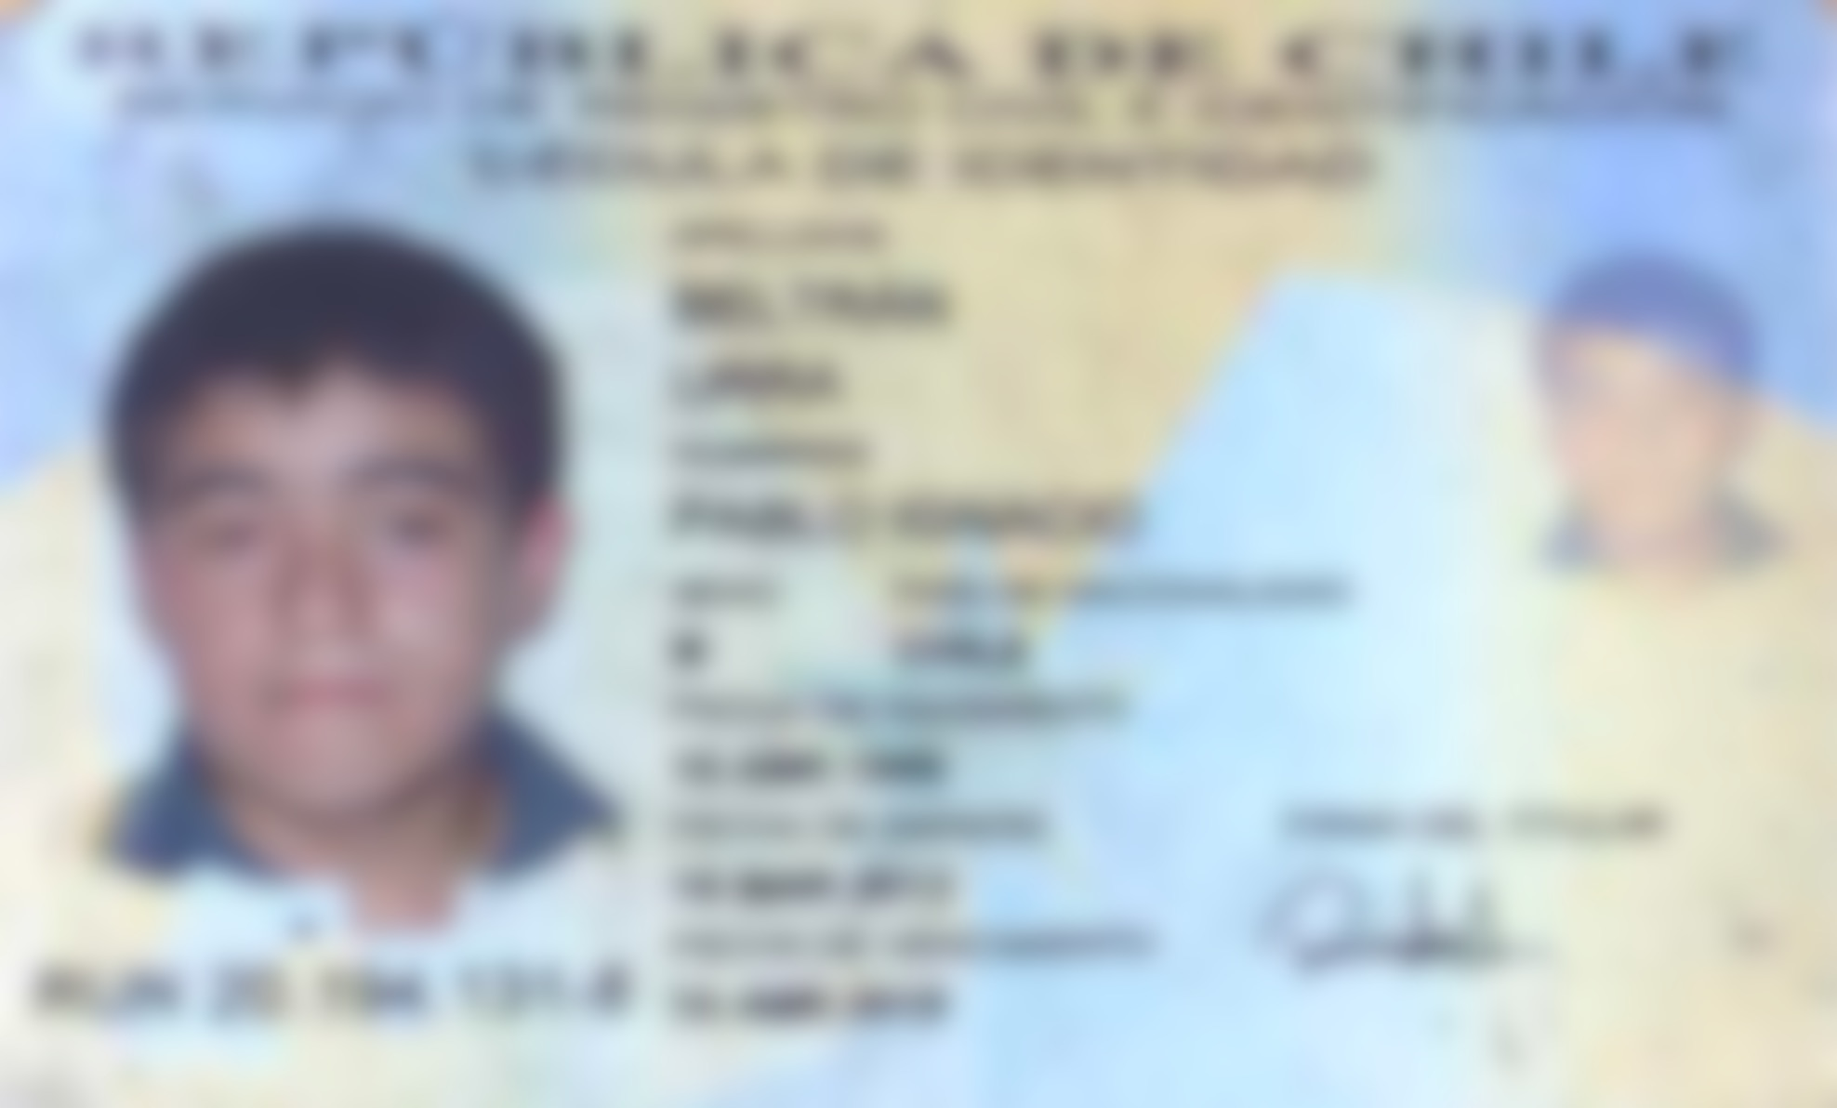

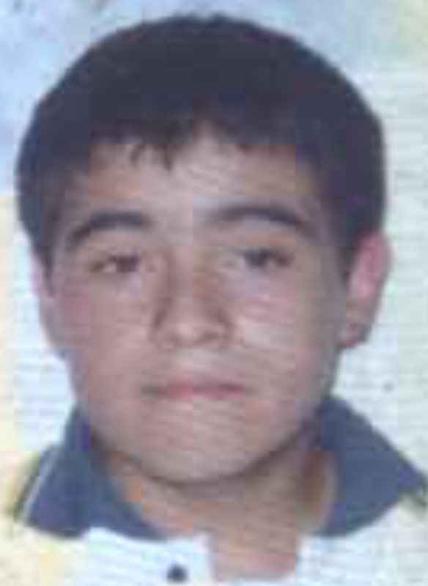
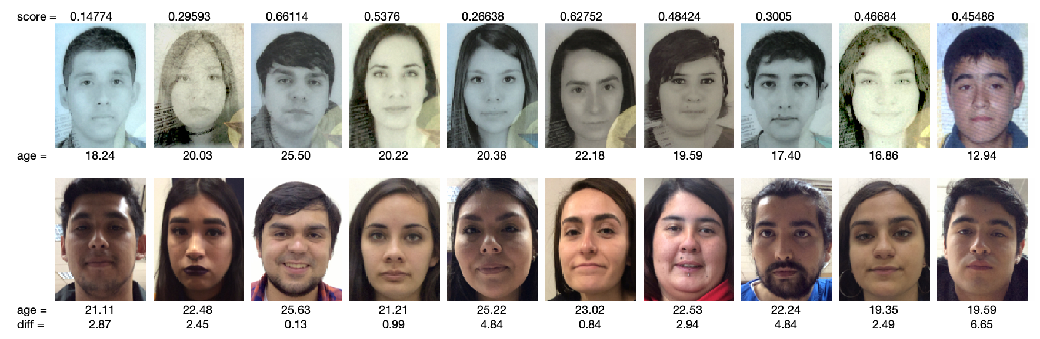
Face verification
across adolescence
ID Photo Selfie
Taken on March, 19th, 2012 Taken on Nov, 12th, 2018
12 years old 19 years old
Is it the same person?

Slide 56
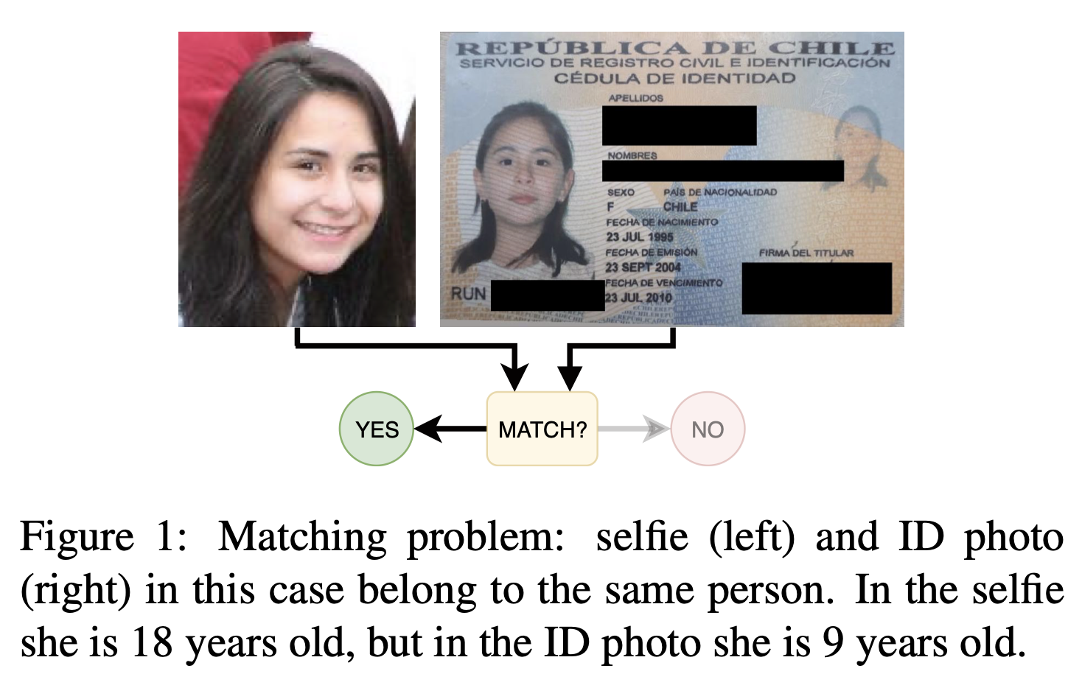

Face Matching: Teenagers to Young Adults
Albiero V, Srinivas N, Villalobos E, Perez-Facuse J, Rosenthal R, Mery D, Ricanek K, Bowyer KW. Identity document to selfie face matching across adolescence. In2020 IEEE International Joint Conference on Biometrics (IJCB) 2020 (pp. 1-9). IEEE.

Slide 57
Face verification
across adolescence
IMAGE 1
IMAGE 2
Albiero V, Srinivas N, Villalobos E, Perez-Facuse J, Rosenthal R, Mery D, Ricanek K, Bowyer KW. Identity document to selfie face matching across adolescence. In2020 IEEE International Joint Conference on Biometrics (IJCB) 2020 (pp. 1-9). IEEE.

Slide 58

Face verification
across adolescence
Age of Image 1 = 18 years old
IMAGE 1
IMAGE 2
Age of Image 2 →
10 12 14 16 18 years
Albiero V, Srinivas N, Villalobos E, Perez-Facuse J, Rosenthal R, Mery D, Ricanek K, Bowyer KW. Identity document to selfie face matching across adolescence. In2020 IEEE International Joint Conference on Biometrics (IJCB) 2020 (pp. 1-9). IEEE.

Slide 59
Face verification
across adolescence
Age of Image 1 = 18 years old
IMAGE 1
IMAGE 2
Age of Image 2 →
10 12 14 16 18 years
Albiero V, Srinivas N, Villalobos E, Perez-Facuse J, Rosenthal R, Mery D, Ricanek K, Bowyer KW. Identity document to selfie face matching across adolescence. In2020 IEEE International Joint Conference on Biometrics (IJCB) 2020 (pp. 1-9). IEEE.

Slide 60
Model Improvements

Slide 61
Model Improvement: I) Human + Computer Vision?

Slide 62

Is it the same person?

Slide 63

Is it the same person? – Eye Tracking

Slide 64



Human + Computer Vision – Example in Face Recognition
Face Recognition in Challenging Images
Is it the same person?
Where do you see when recognizing a face?
Can we include this attention map in our model?

Slide 65
Model Improvement: 2) What about Transformers?

Slide 66

Visual Transformer (ViT)
Zhong, Y., & Deng, W. (2021). Face transformer for recognition. arXiv preprint arXiv:2103.14803.

Slide 67

Visual Transformer (ViT)

Slide 68
Model Improvement: 3) Do we need color images?

Slide 69

Is color relevant in Face Recognition?
Accuracy in Face Recognition using grayscale or color images are very similar.
Bhatta, A., Mery, D., Wu, H., Annan, J., King, M. C., & Bowyer, K. W. (2023). Our Deep CNN Face Matchers Have Developed Achromatopsia. arXiv preprint arXiv:2309.05180.

Slide 70

Is color relevant in Face Recognition?
It is possible to reduce the size of the architecture using only one channel as input (instead of three channels)

Slide 71
Model Improvement: 4) Better GANs?

Slide 72







Problems with GANs for Super-Resolution
LR
56x56
LR
28x28
LR
14x14
ORIGINAL
112x112
HR
112x112
HR
112x112
HR
112x112

Slide 73





GAN for Super-Resolution
Ground truth: real/fake
Real image
Discriminator
HR
real/fake
Generator
error
LR
Fake image
SR
error
Notes:
Zero-sum game theory

Slide 74
GAN for Super-Resolution
Embedding
Ground truth: real/fake
Real image
Discriminator
HR
real/fake
Generator
error
LR
Embedding
Fake image
SR
error
Notes:
Zero-sum game theory

Slide 75
GAN for Super-Resolution
Embedding
Ground truth: real/fake
Real image
Discriminator
HR
real/fake
Generator
error
LR
Embedding
Fake image
SR
error
Notes:
Zero-sum game theory

Slide 76
Ethics

Slide 77

Privacy
versus
Security
The eternal dilemma
Are we giving up privacy for security?
https://www.shponline.co.uk/technology-2/facial-recognition-boom-surveillance-fears-could-be-assuaged-by-built-in-privacy-protection/

Slide 78



Slide 79


Slide 80
Ethics:
Ethics are shared principles that help us distinguish right from wrong.
In Face Recognition, there are possible undesired consequences, for privacy, fairness, etc...
How do we decide what is OK to do? → ETHICS!
We must be ethical when using…
We must be ethical when developing…
We must be ethical when teaching… face recognition

Slide 81
Bonus Track:
ChatGPT ?

Slide 82
What about ChatGPT?
ChatGPT: (...) OpenAI says that it is not ready to roll out facial recognition for public use as it may invite legal issues in jurisdictions that require consent for using biometric data.
BiometricUpdate.com July/2023

Slide 83



What about ChatGPT?
PROPMT (ChatBot Google Bard)
INPUT IMAGE
OUTPUT

Slide 84

What about ChatGPT?
PROPMT (ChatBot Google Bard)

Slide 85

Almost Always
Doing the right thing does not automatically bring success.
But compromising ethics almost always leads to failure
Erika Andersen
* From: Course ‘Data Science Ethics’ by University of Michigan. Prof. H.V. Jagadish

